Slide 1




Universitat Oberta
de Catalunya
uoc.edu
IMPACT OF 5-FU TREATMENT ON TUMOR CELL PLASTICITY IN COLORECTAL CANCER
Tutor/a de TFM: Laia Bassaganyas Bars
Professor/a responsable de l’assignatura: David Merino Arranz
Autor/a: Miquel Gratacós i Aurich

Slide 2
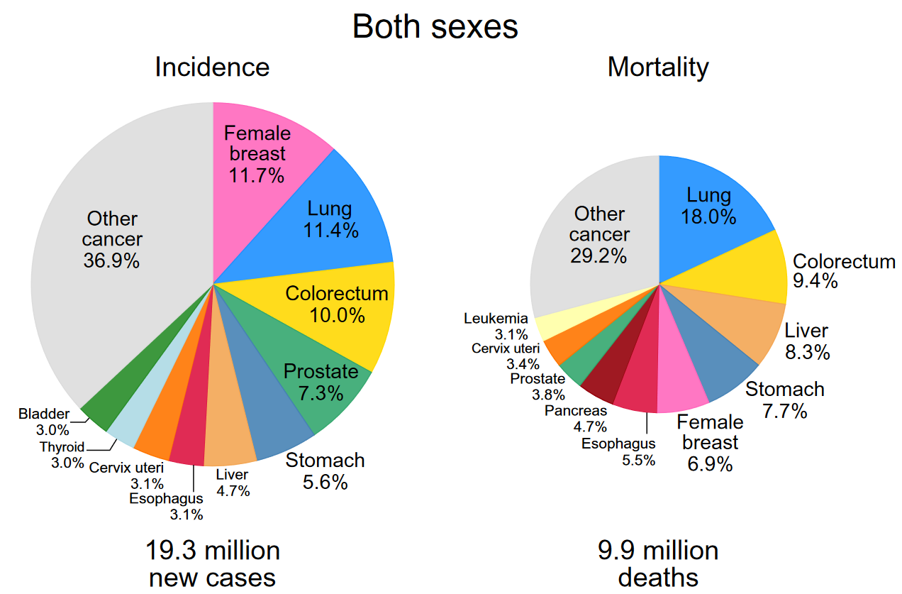
Universitat Oberta
de Catalunya
uoc.edu
INTRODUCTION
More than 1.9 million new colorectal cancer cases.
935 000 deaths were estimated (2020)
Third in incidence, second in mortality
Can be considered a marker of socioeconomic development
Primary prevention as key strategy to reduce the growing burden
Fig 1. Distribution of incidence and mortality rates from the Top 10 Most Common Cancers in 2020 in Both Sexes. Image extracted from GLOBOCAN 2020.
Notes:
"El cáncer colorrectal (CRC) es el tercer tipo de cáncer más diagnosticado mundialmente en hombres y mujeres.“
"A pesar de los avances en diagnóstico y tratamiento, aproximadamente la mitad de los pacientes con CRC experimentan recurrencia en los primeros 5 años post-cirugía y quimioterapia."

Slide 3
Universitat Oberta
de Catalunya
uoc.edu
TREATMENT RESISTANCE
Surgery is the primary curative treatment.
5-FU Chemotherapy as main systemic treatment since the 1990s.
Intravenous or oral administration
Blockage DNA and RNA synthesis
One of the most effective treatments
Could be administrated with other drugs
Some patients could develop resistance to 5-FU

Slide 4
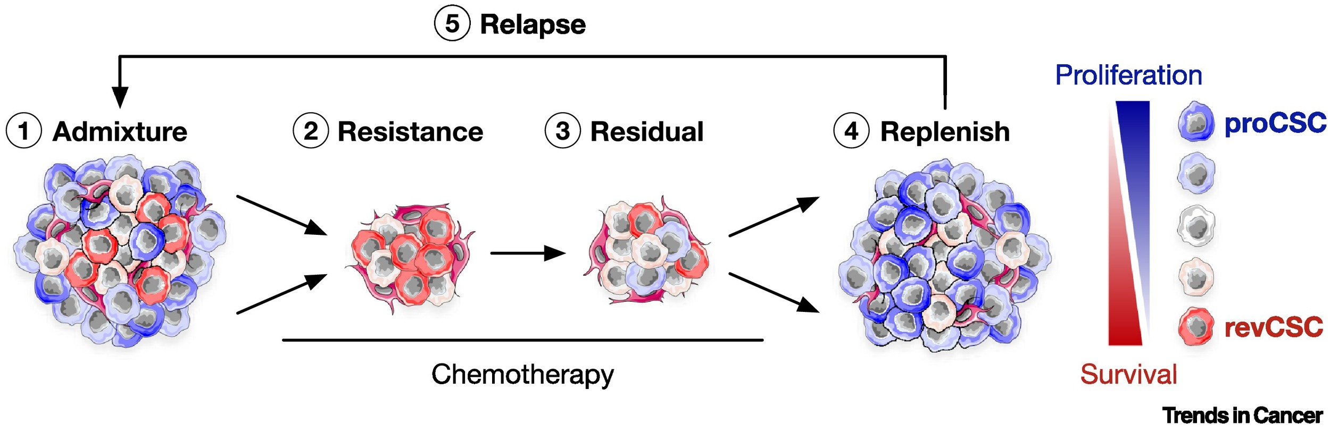
Universitat Oberta
de Catalunya
uoc.edu
CELLULAR PLASTICY
Cell plasticity is key in the tolerance to the treatment for Colorectal cancer (CRC).
Cancer stem cells (CSCs) crucial for tumor progress, and all the mechanism that promote the relapse of the cancer.
Fig 2. Colorectal cancer (CRC) chemorefractory plasticity cycle model. Image extracted from: Plastic persisters: revival stem cells in colorectal cancer. https://doi.org/10.1016/j.trecan.2023.11.003

Slide 5
Universitat Oberta
de Catalunya
uoc.edu
scRNA-seq TECHNOLOGY

Slide 6
Universitat Oberta
de Catalunya
uoc.edu
scRNA-seq TECHNOLOGY

Slide 7
Universitat Oberta
de Catalunya
uoc.edu
OBJECTIVES
Characterize relevant cancer cell subpopulations appearing in response to 5-FU. *
Establish CCC networks between cell subpopulations. *
Demonstrate that translational control is one of the molecular mechanisms responsible for cellular reprogramming in response to 5-FU.
Determine the exact role of these subpopulations in treatment tolerance and tumor recurrence.
* Specifically, this study will focus on achieving objectives 1 and 2.

Slide 8
Universitat Oberta
de Catalunya
uoc.edu
METHODS

Slide 9
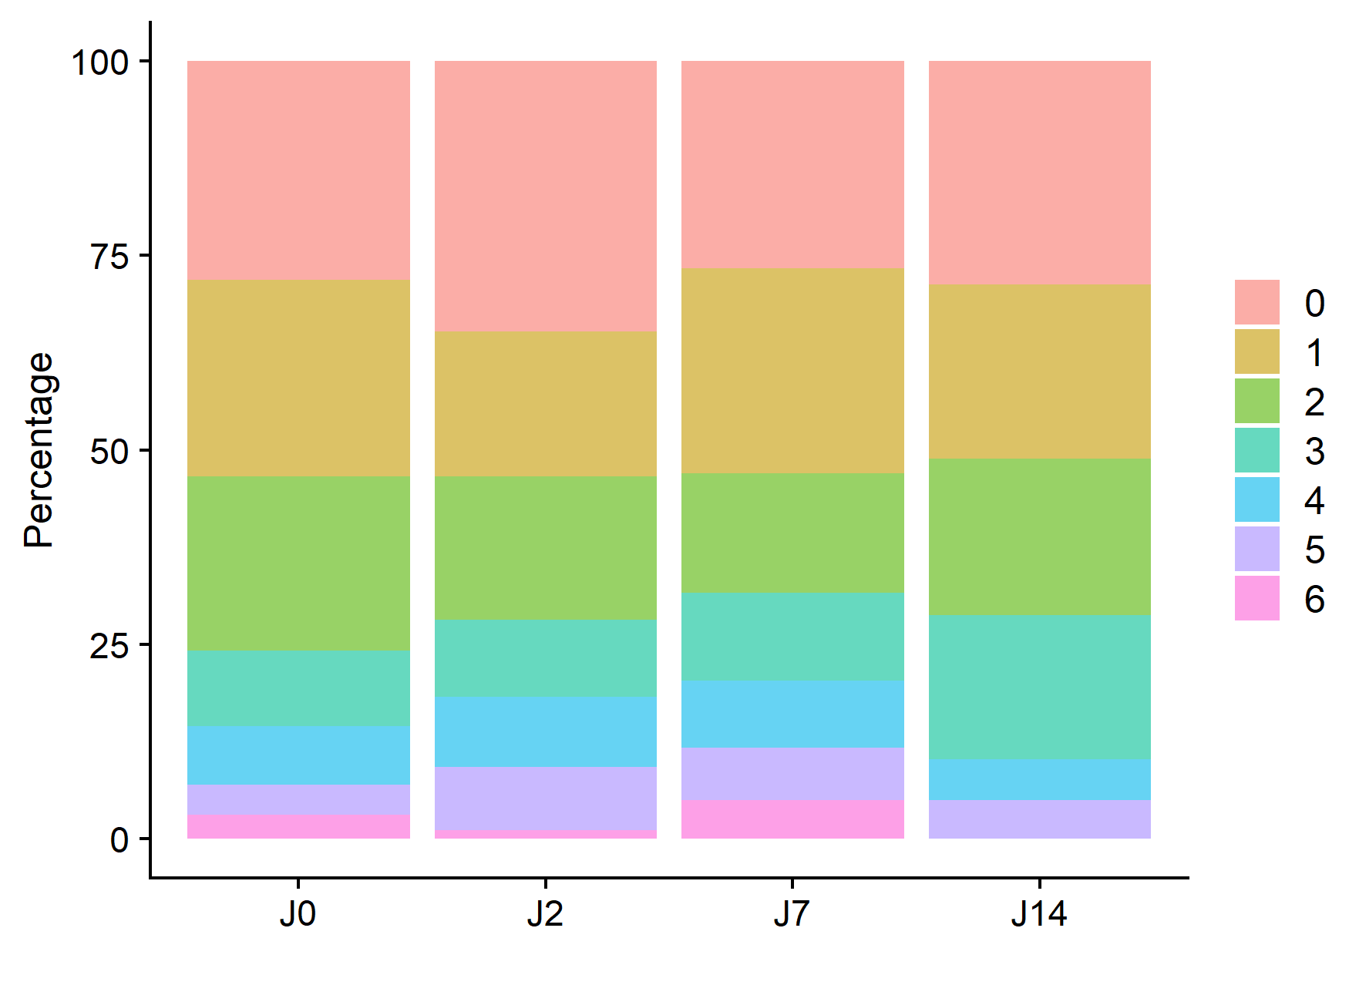
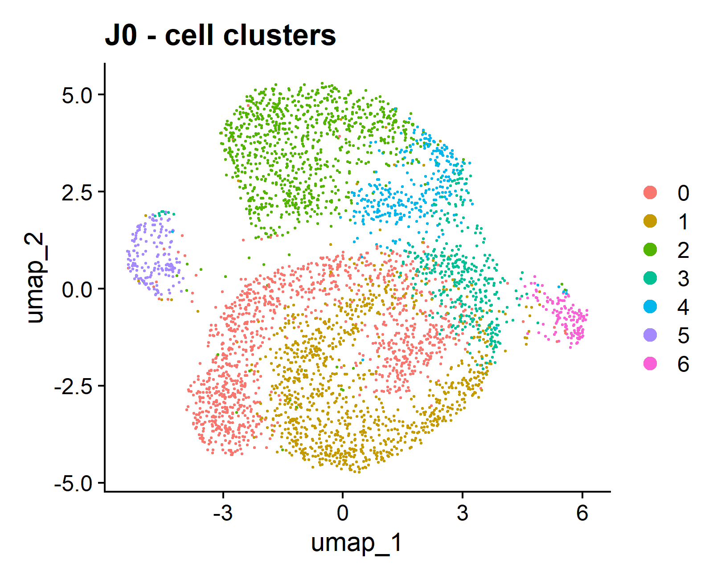
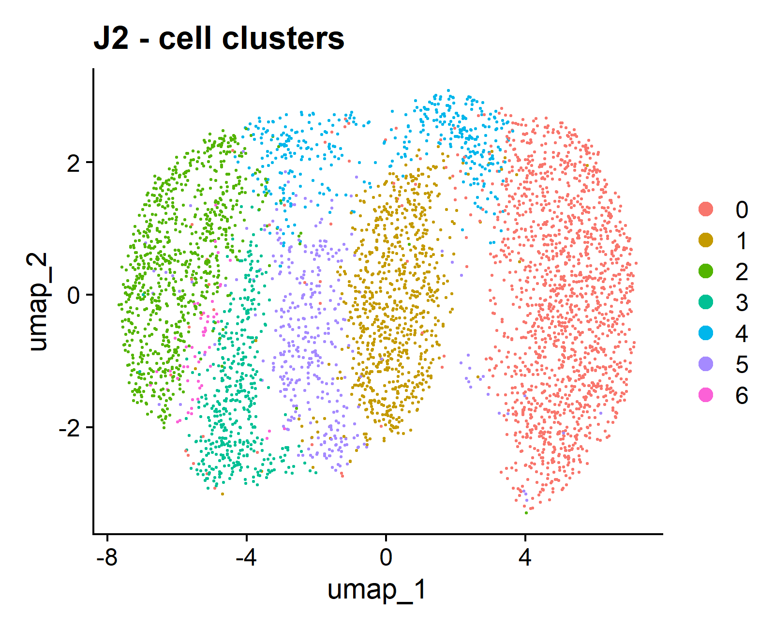
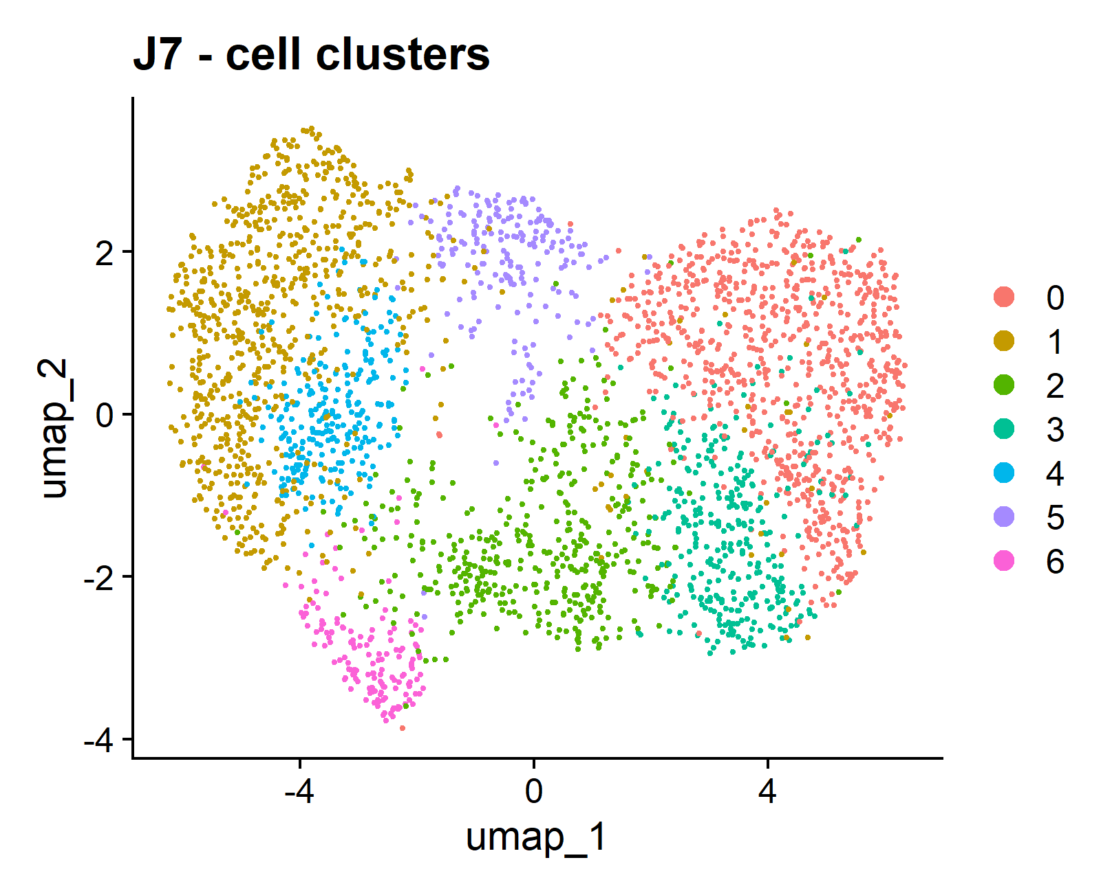
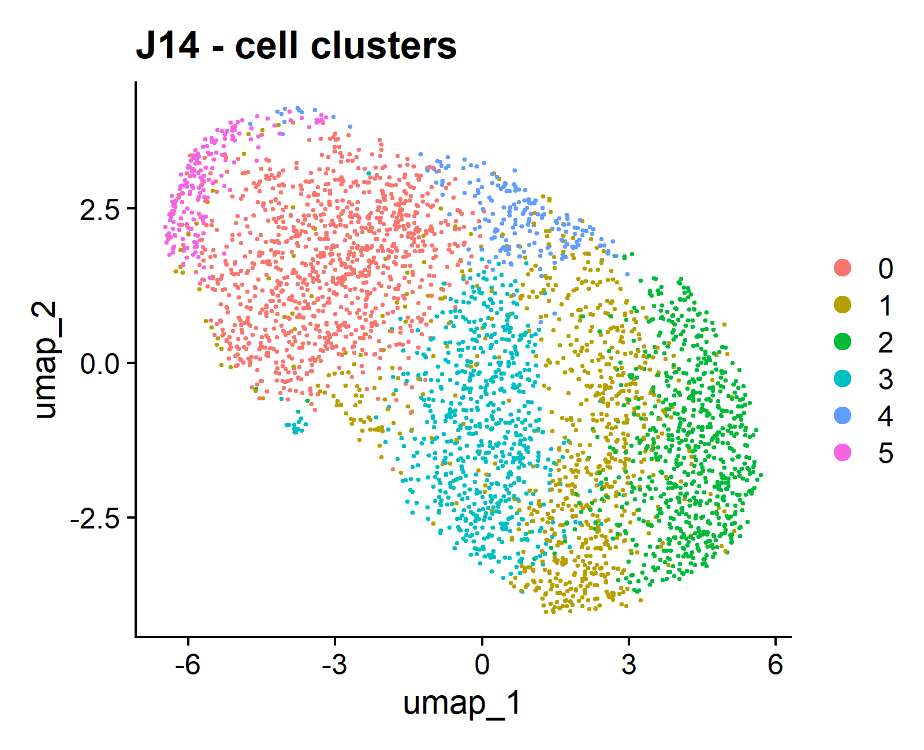
Universitat Oberta
de Catalunya
uoc.edu
RESULTS
B)
A)
C)
D)

Slide 10
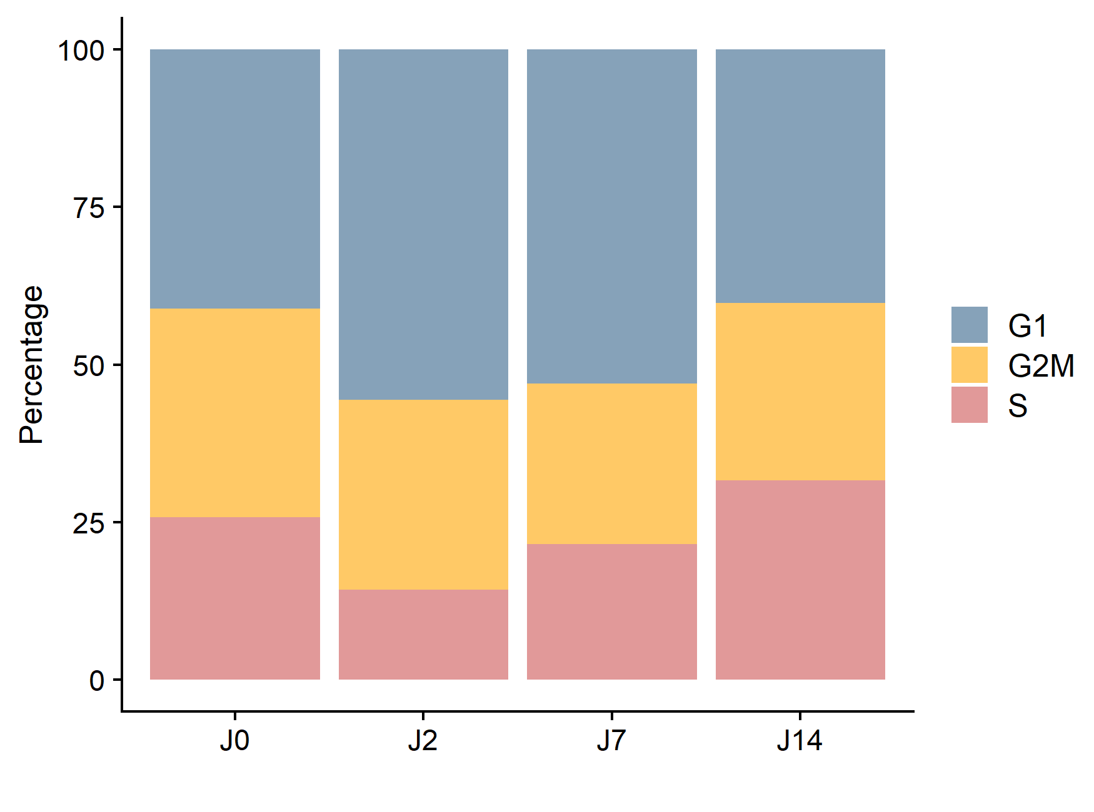
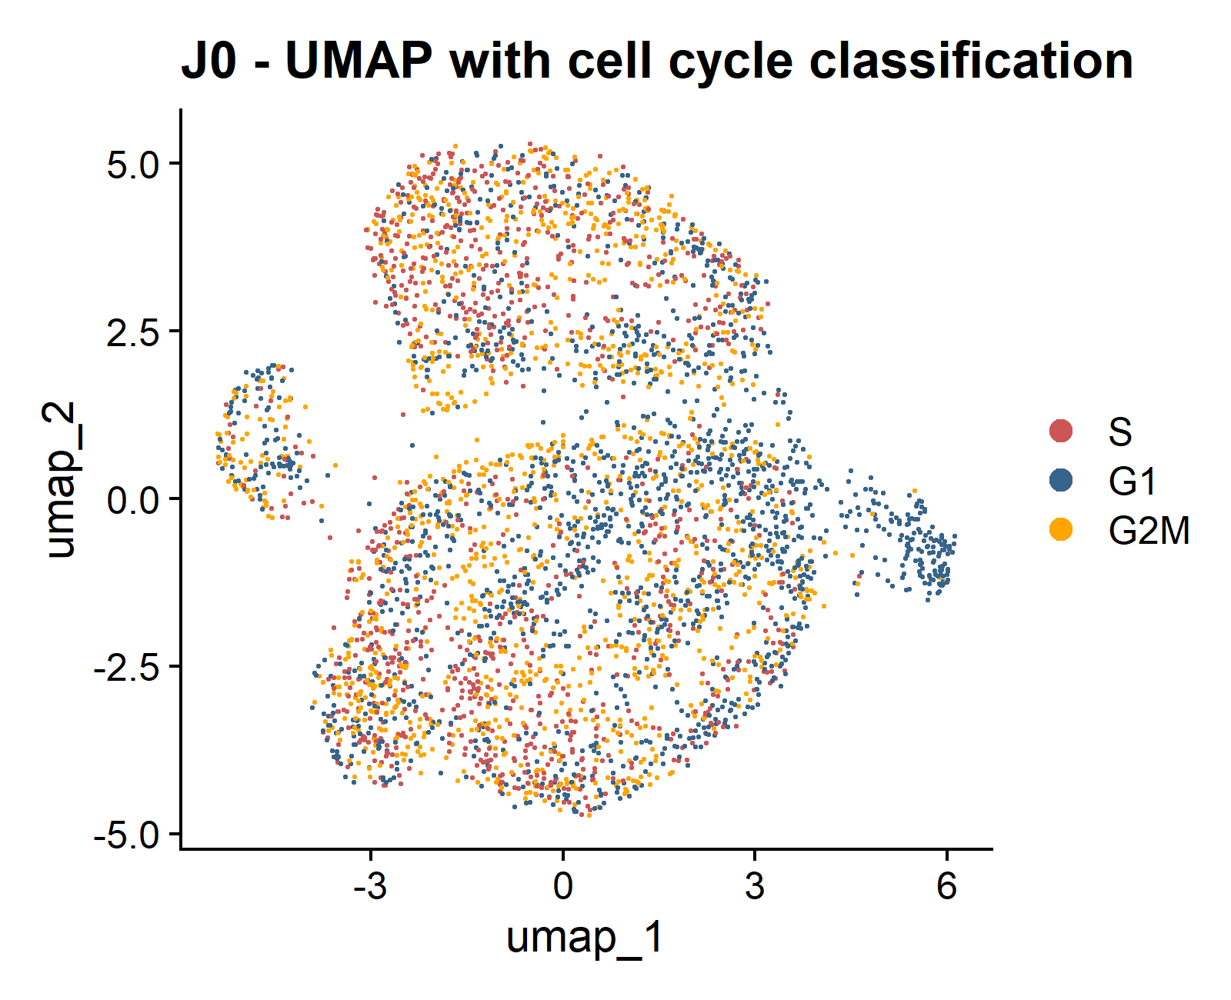
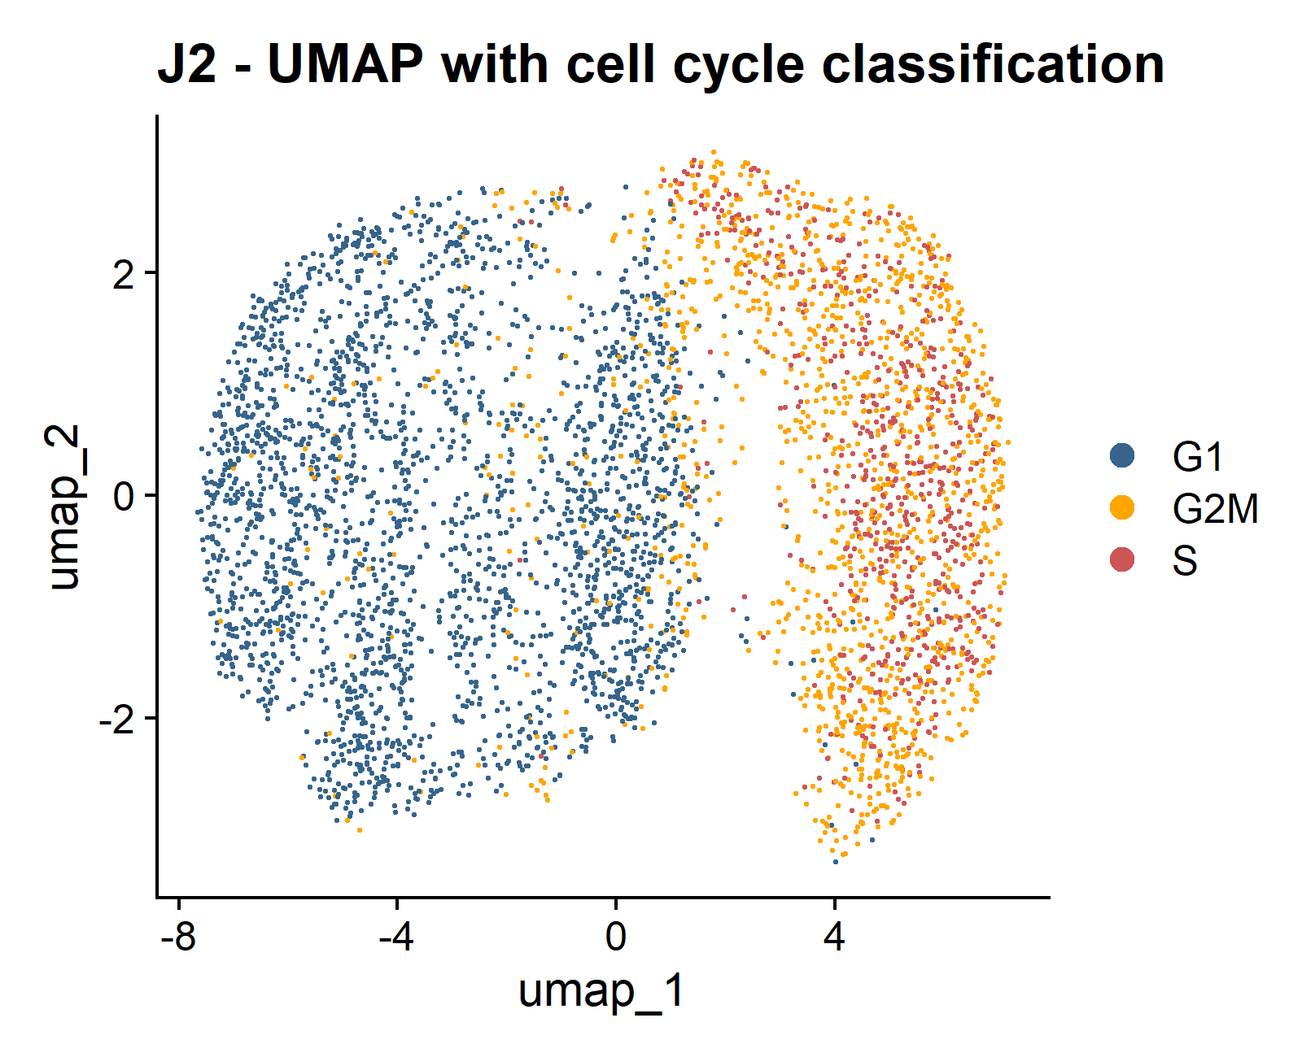
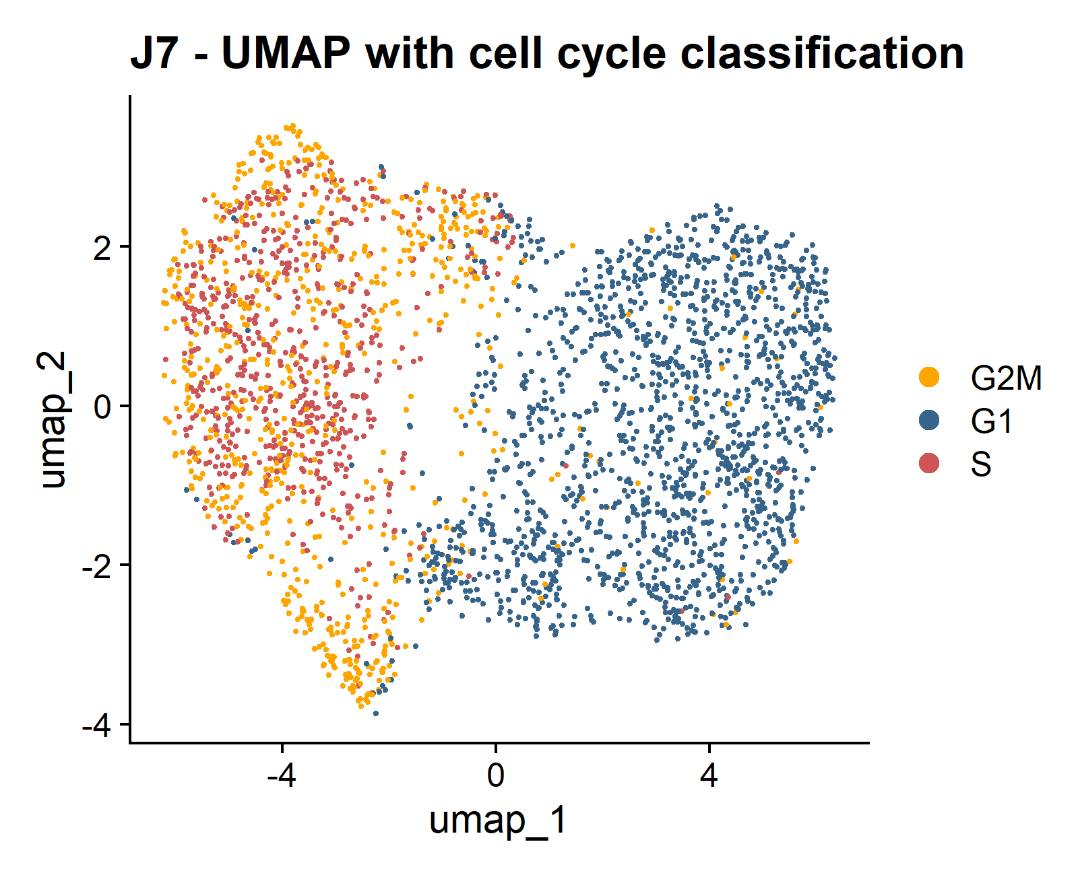
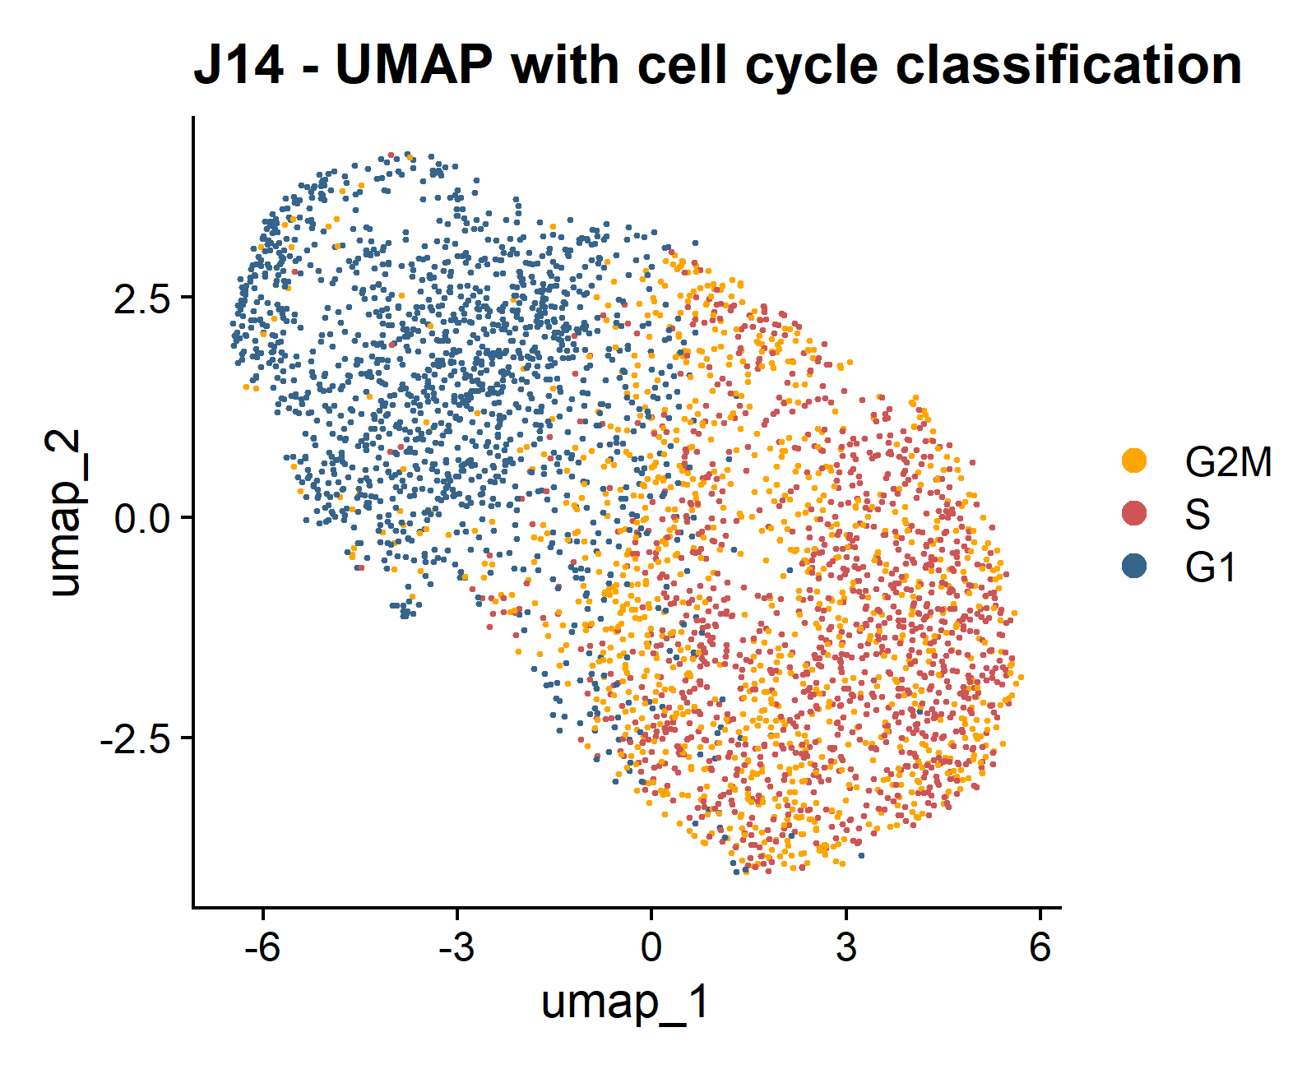
Universitat Oberta
de Catalunya
uoc.edu
RESULTS
A)
B)
C)
D)

Slide 11
Universitat Oberta
de Catalunya
uoc.edu
RESULTS

Slide 12
Universitat Oberta
de Catalunya
uoc.edu
RESULTS

Slide 13
Universitat Oberta
de Catalunya
uoc.edu
RESULTS

Slide 14
Universitat Oberta
de Catalunya
uoc.edu
RESULTS

Slide 15
Universitat Oberta
de Catalunya
uoc.edu
RESULTS

Slide 16
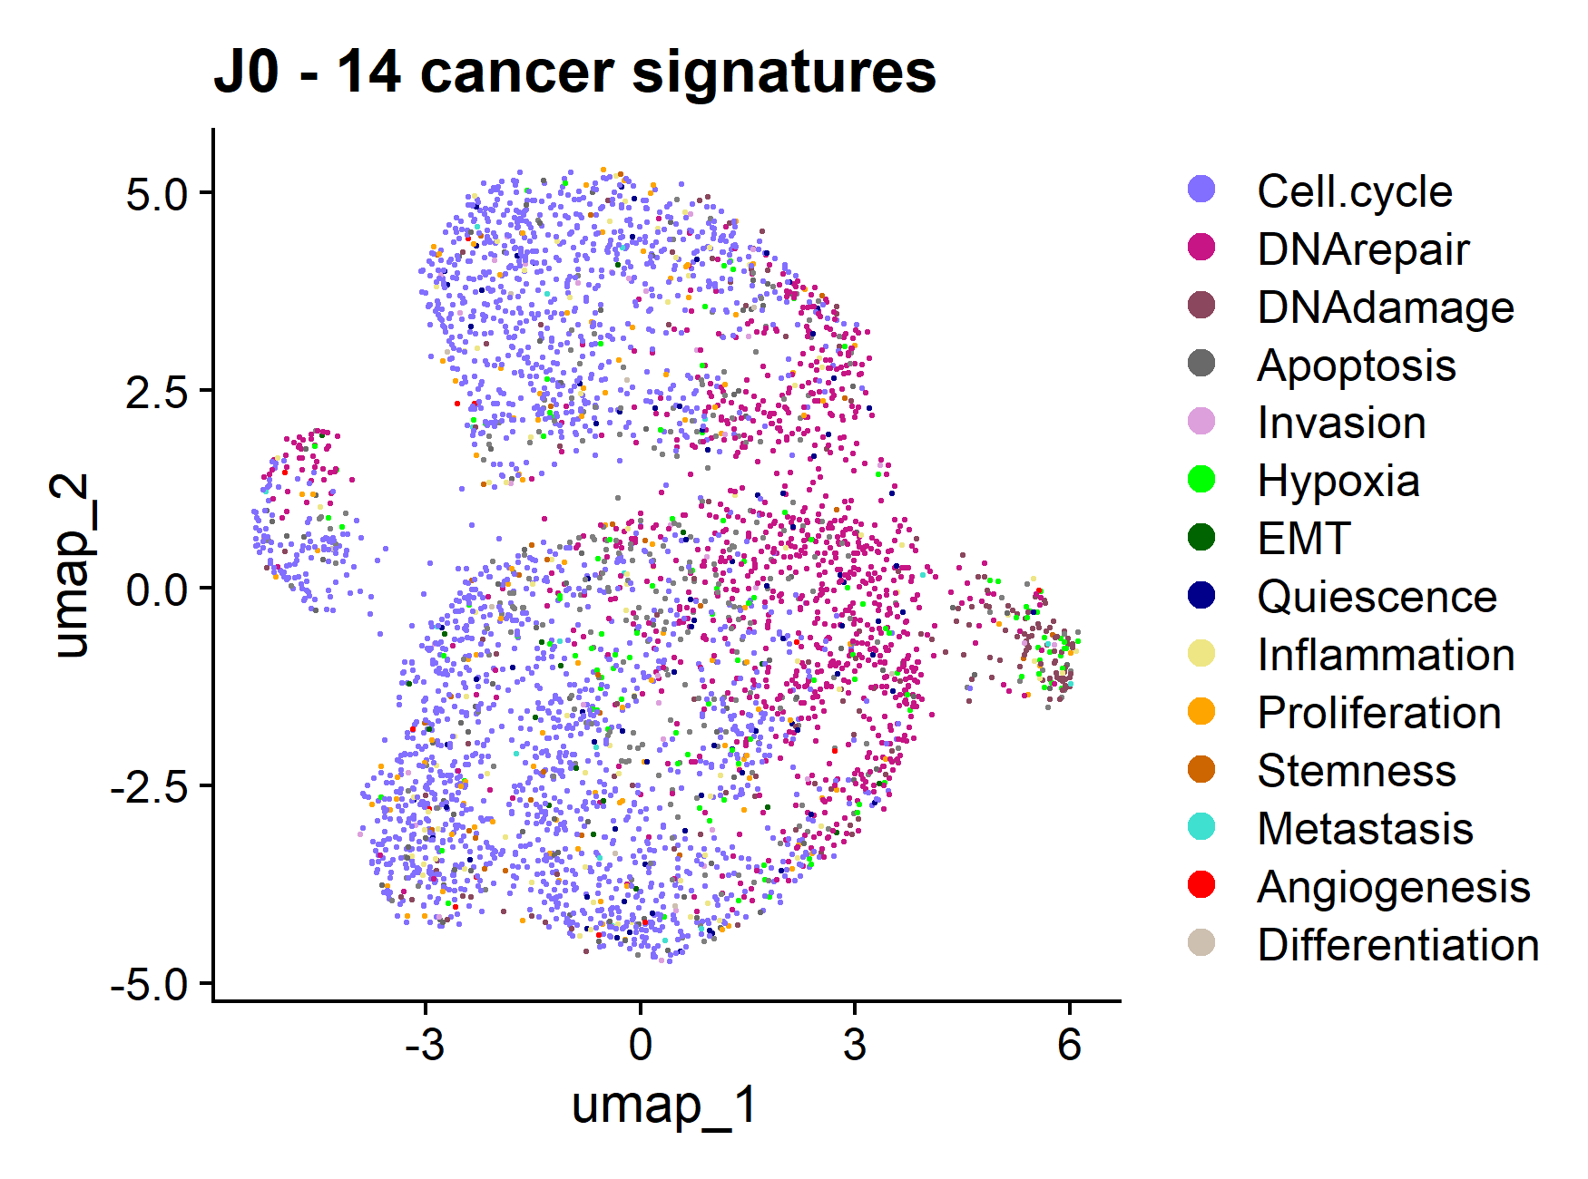
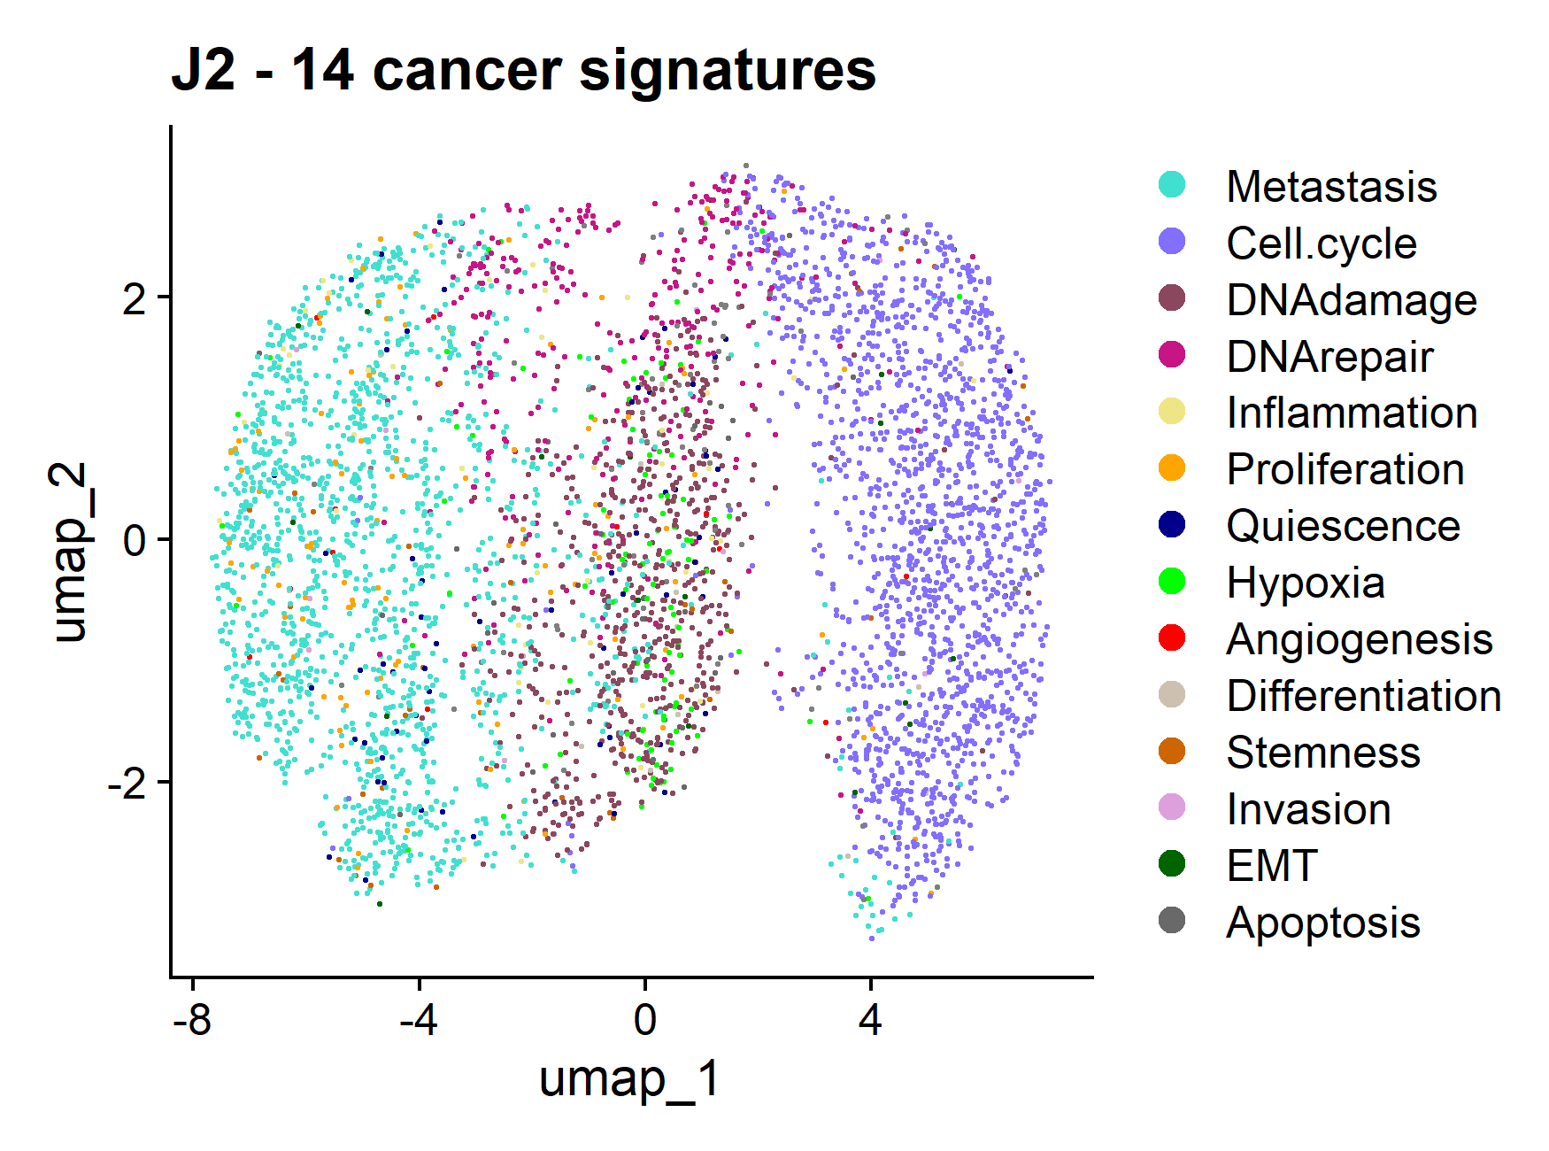
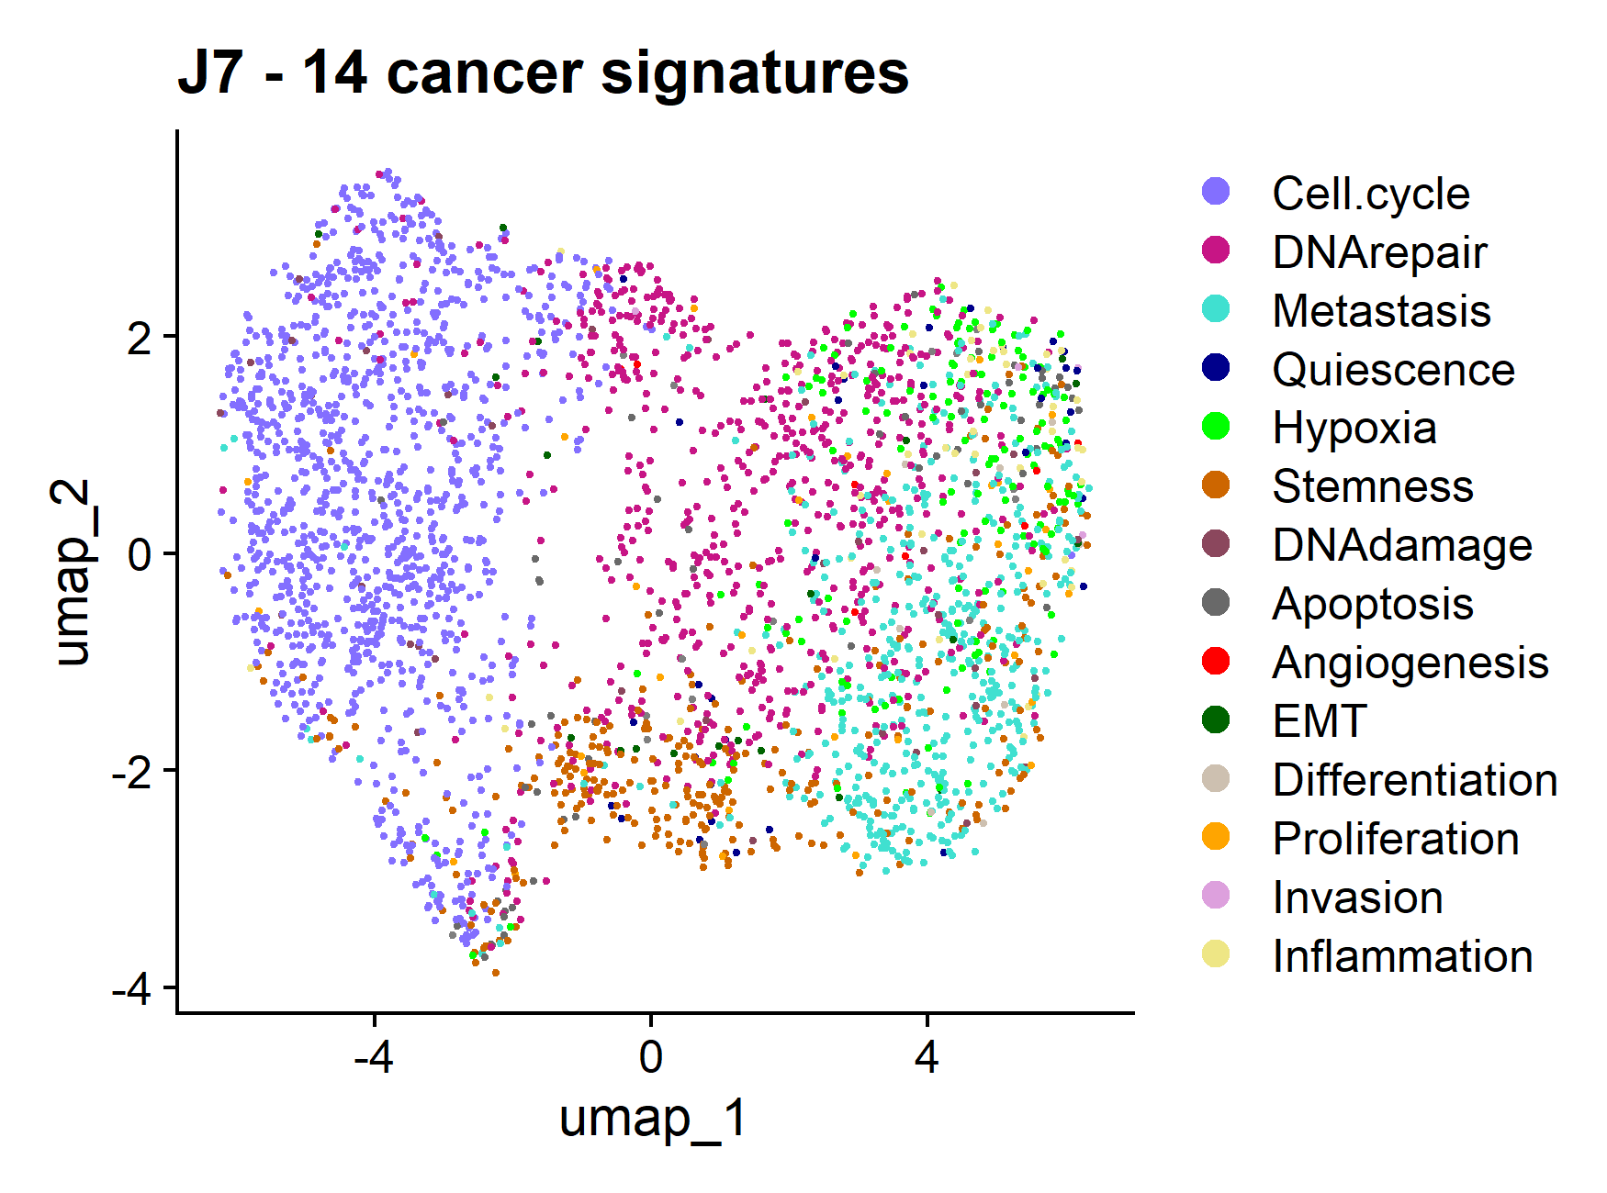
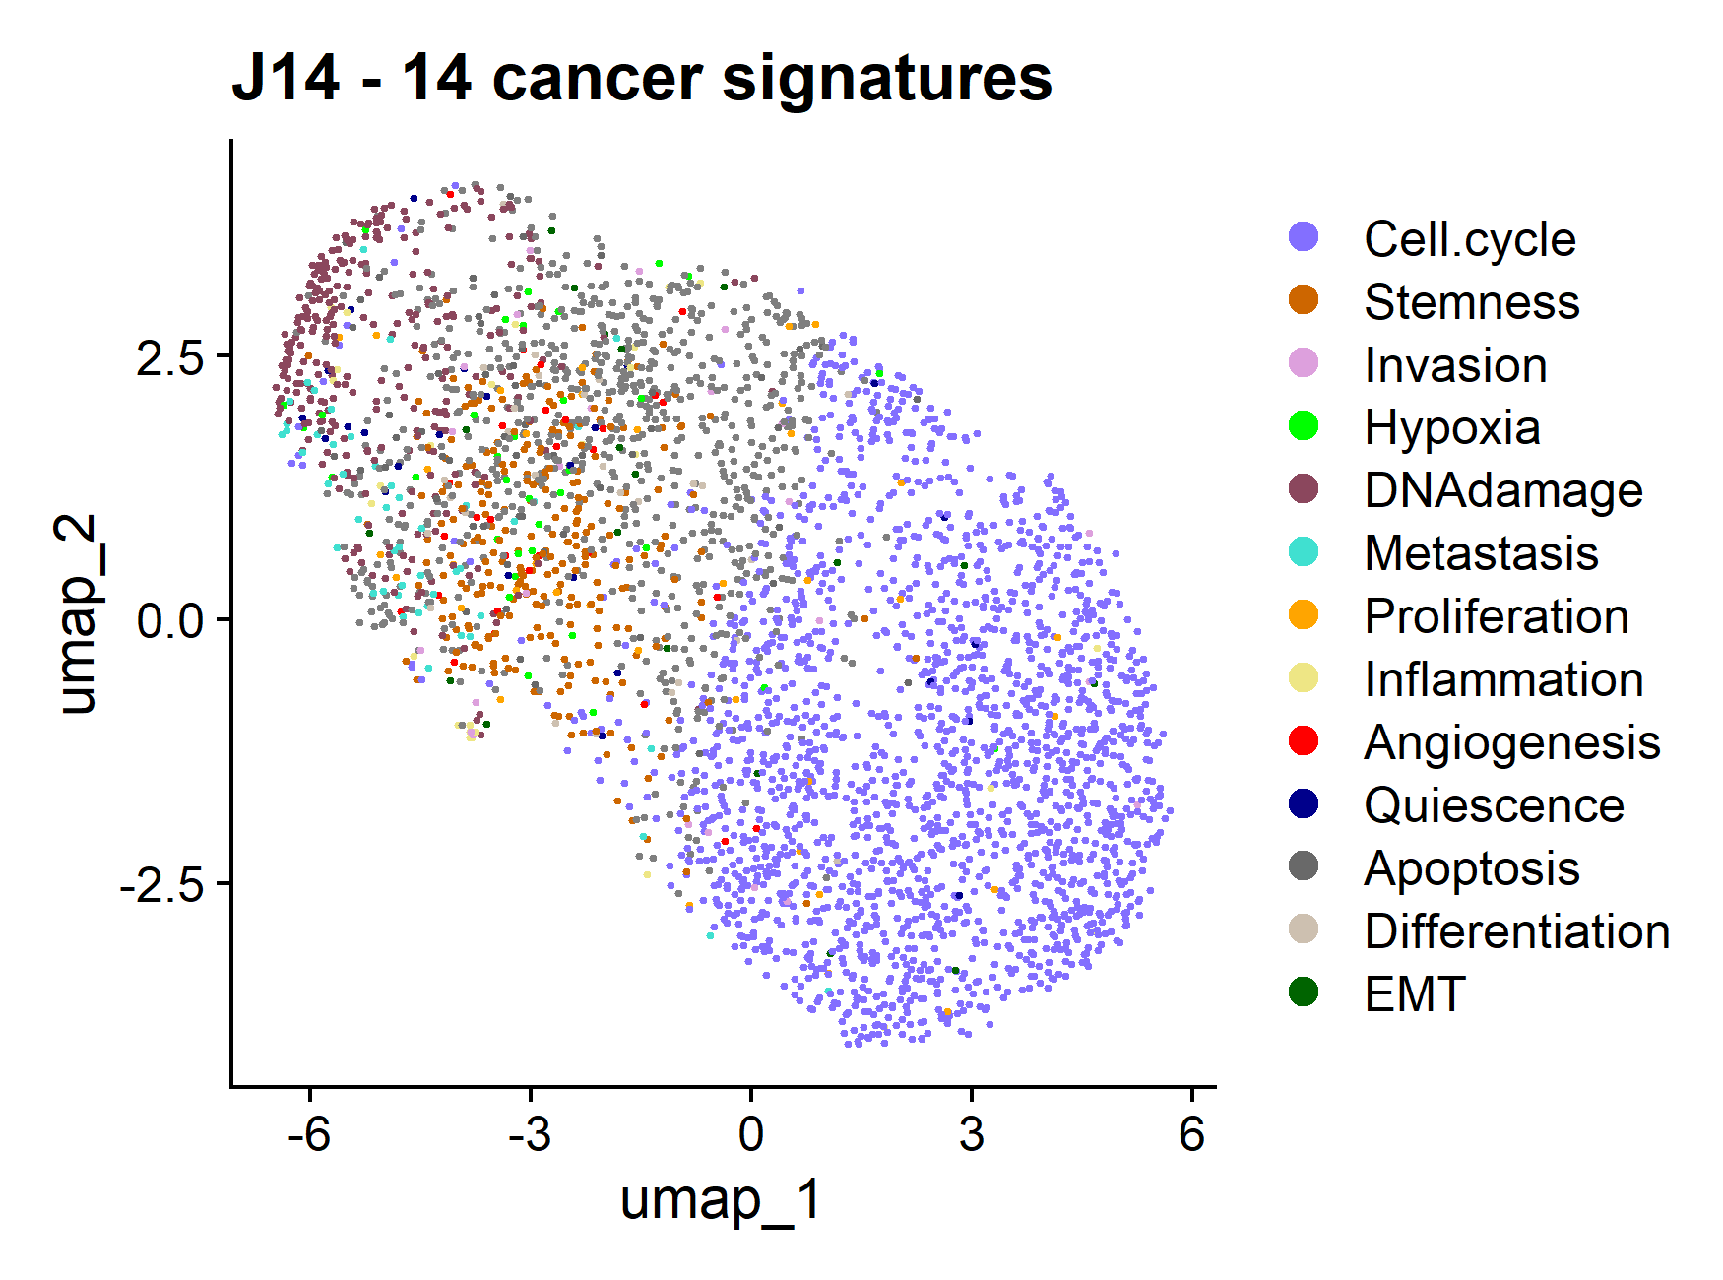
A)
B)
C)
D)

Slide 17
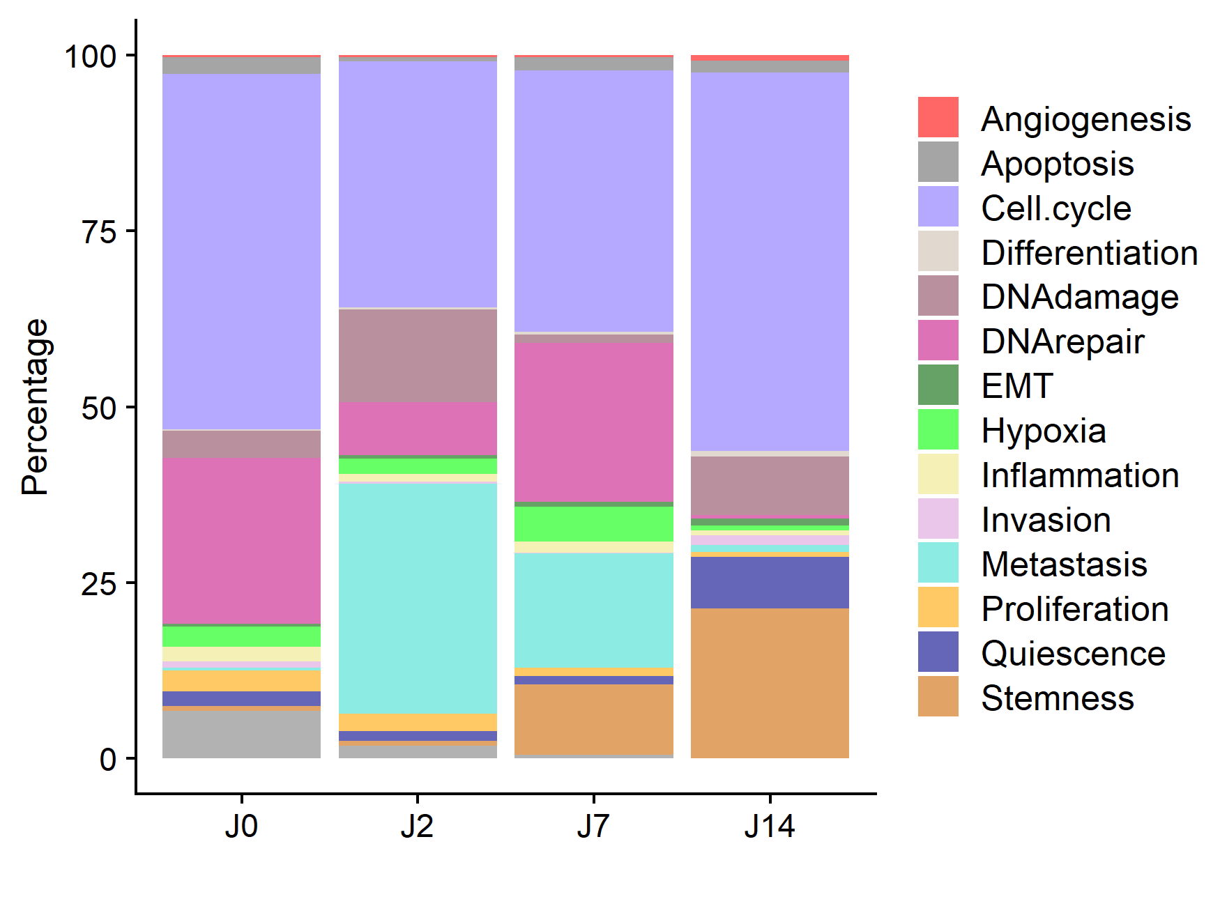
uoc.edu

Slide 18
INTERACTION CCC
uoc.edu

Slide 19
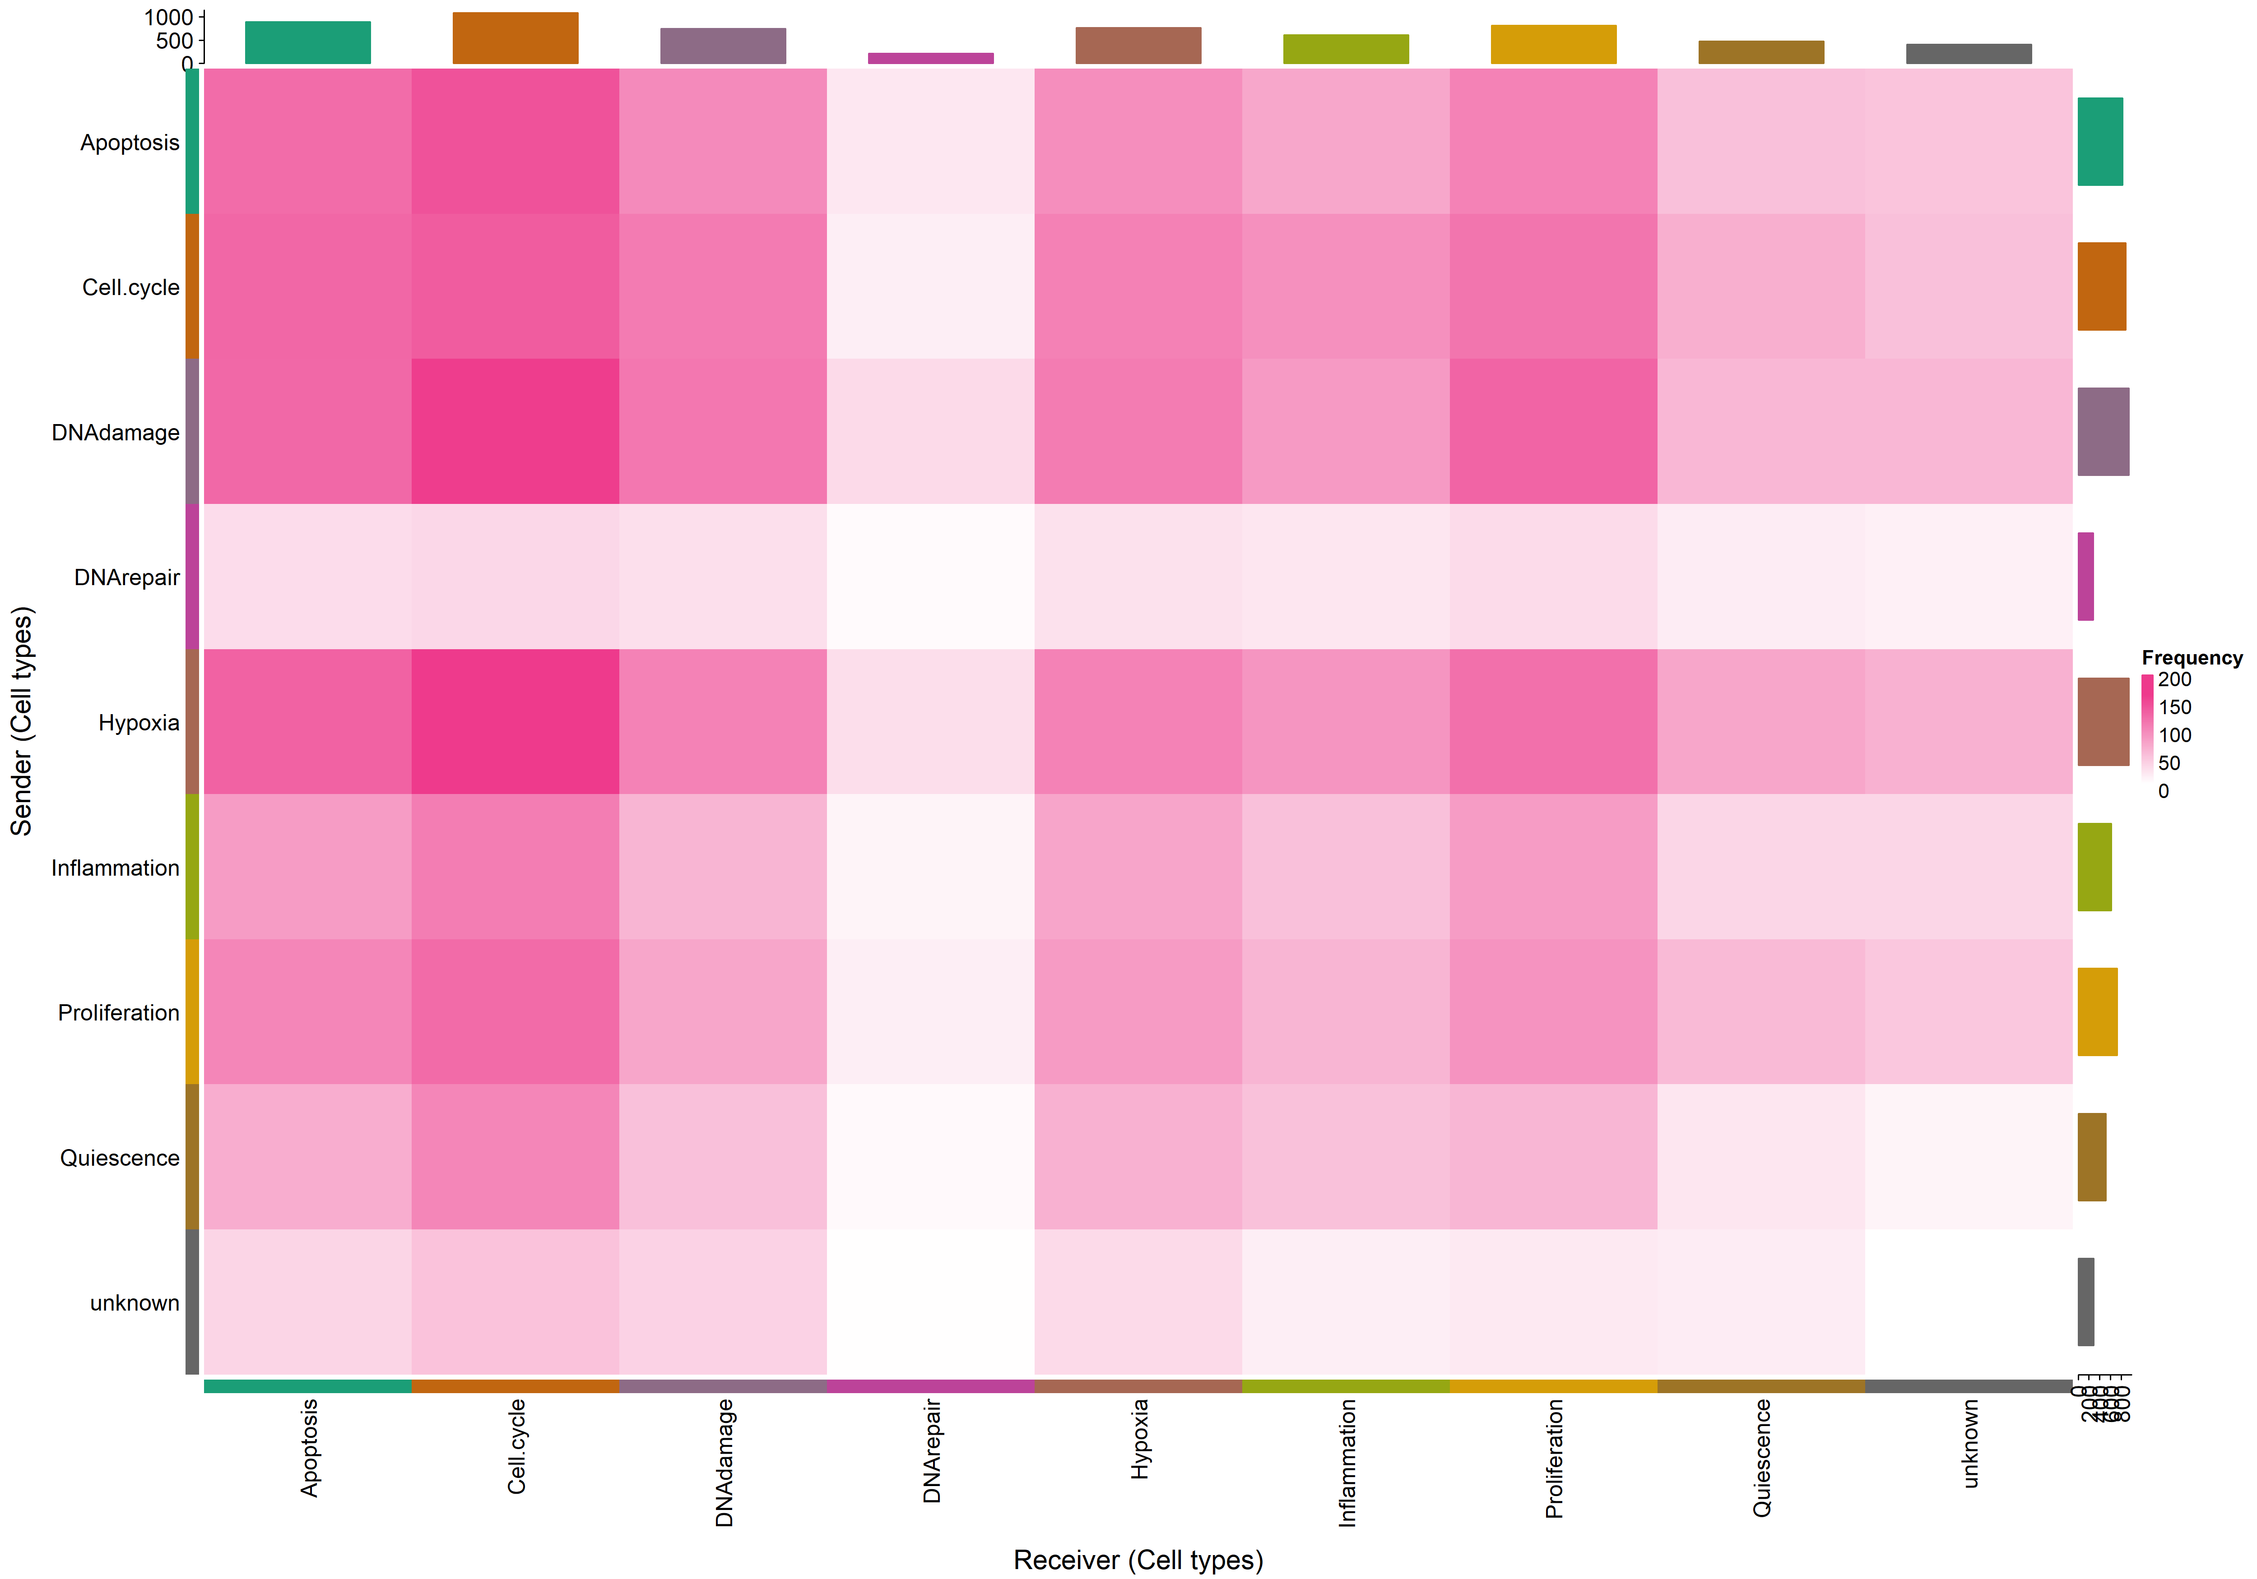
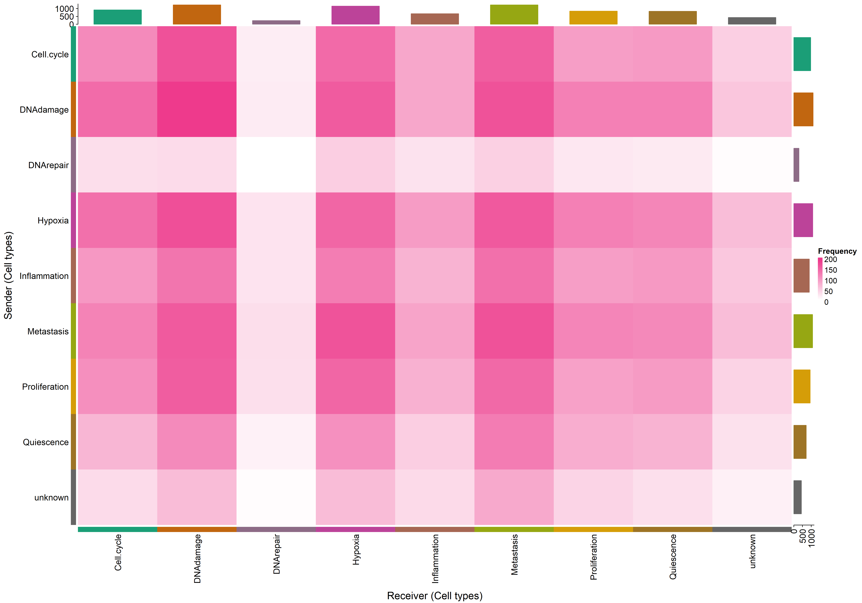
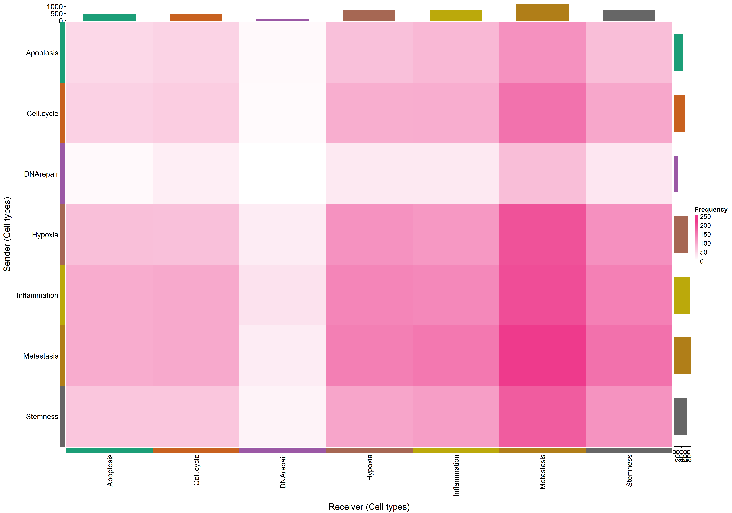
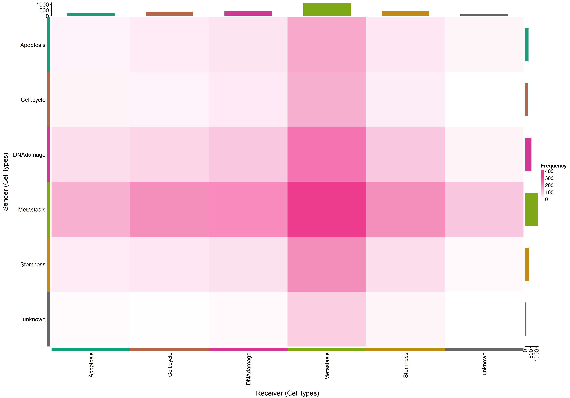
uoc.edu

Slide 20
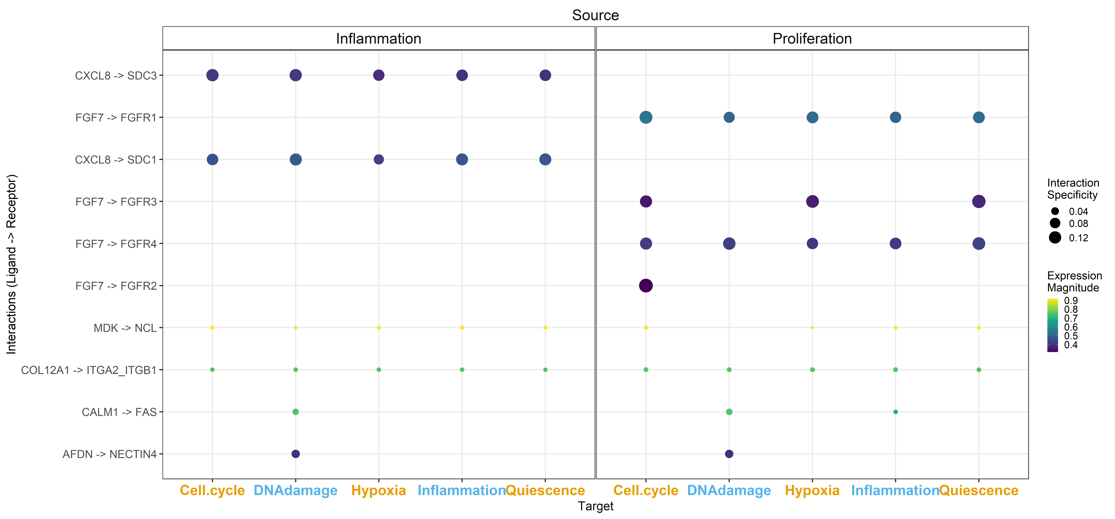
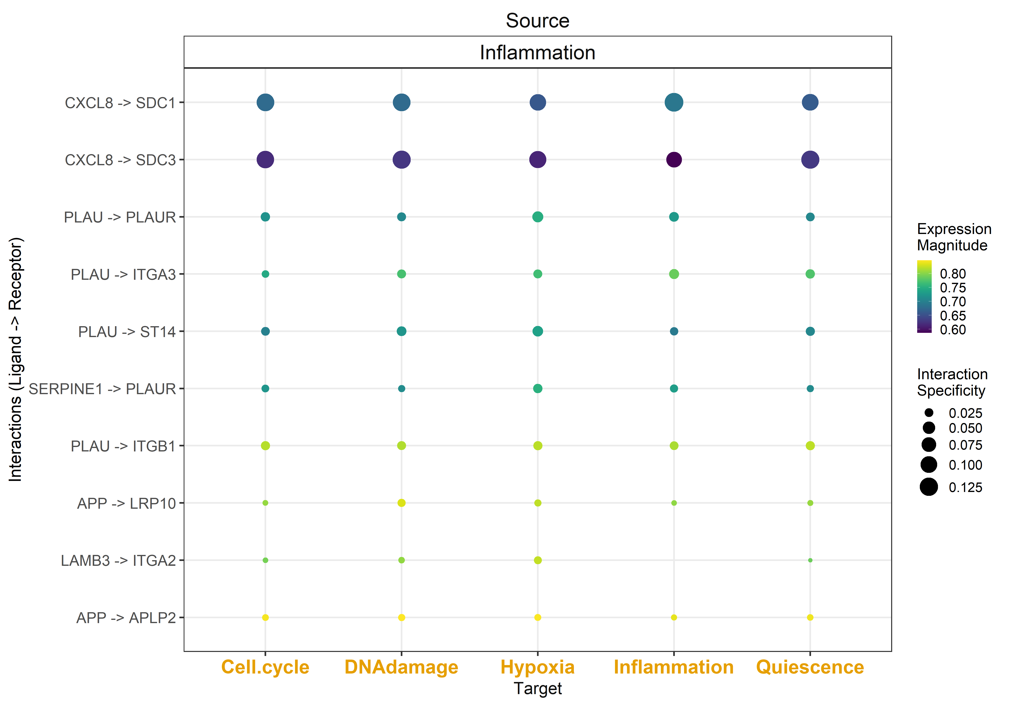
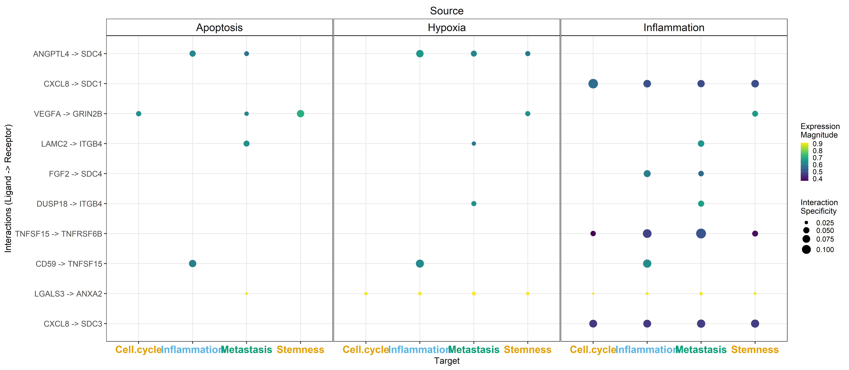
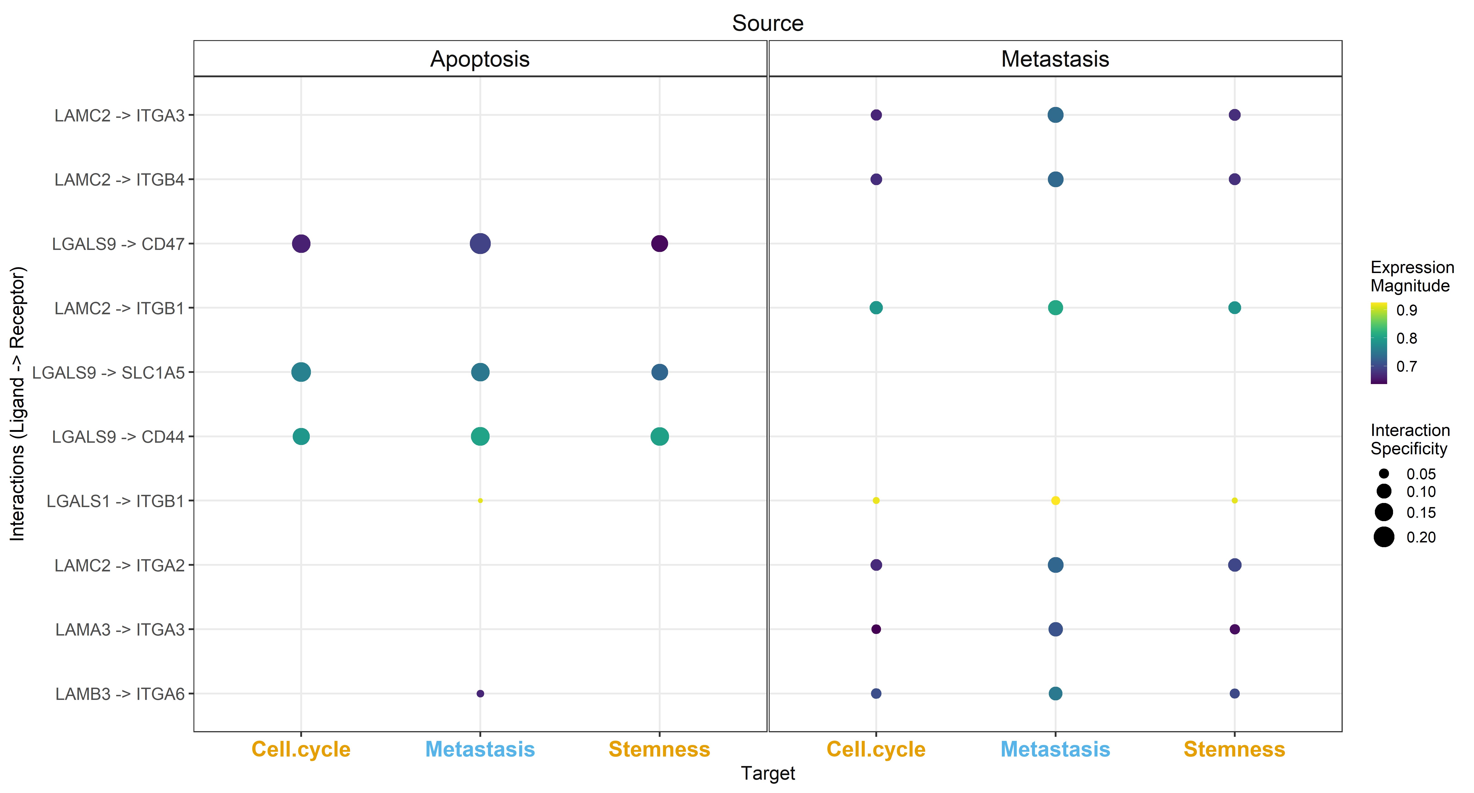
uoc.edu

Slide 21
INTEGRATIVE
uoc.edu

Slide 22
uoc.edu

Slide 23
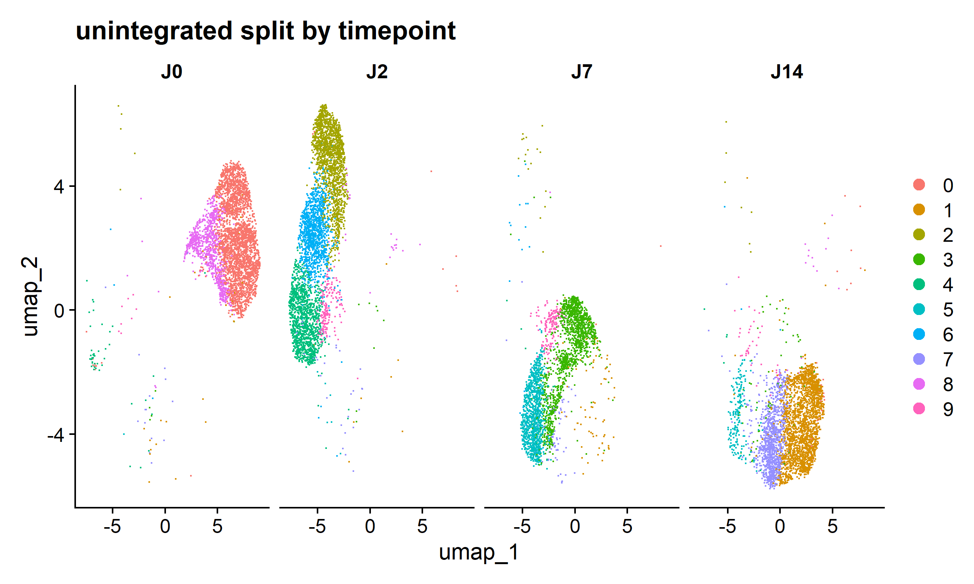
uoc.edu

Slide 24
uoc.edu

Slide 25
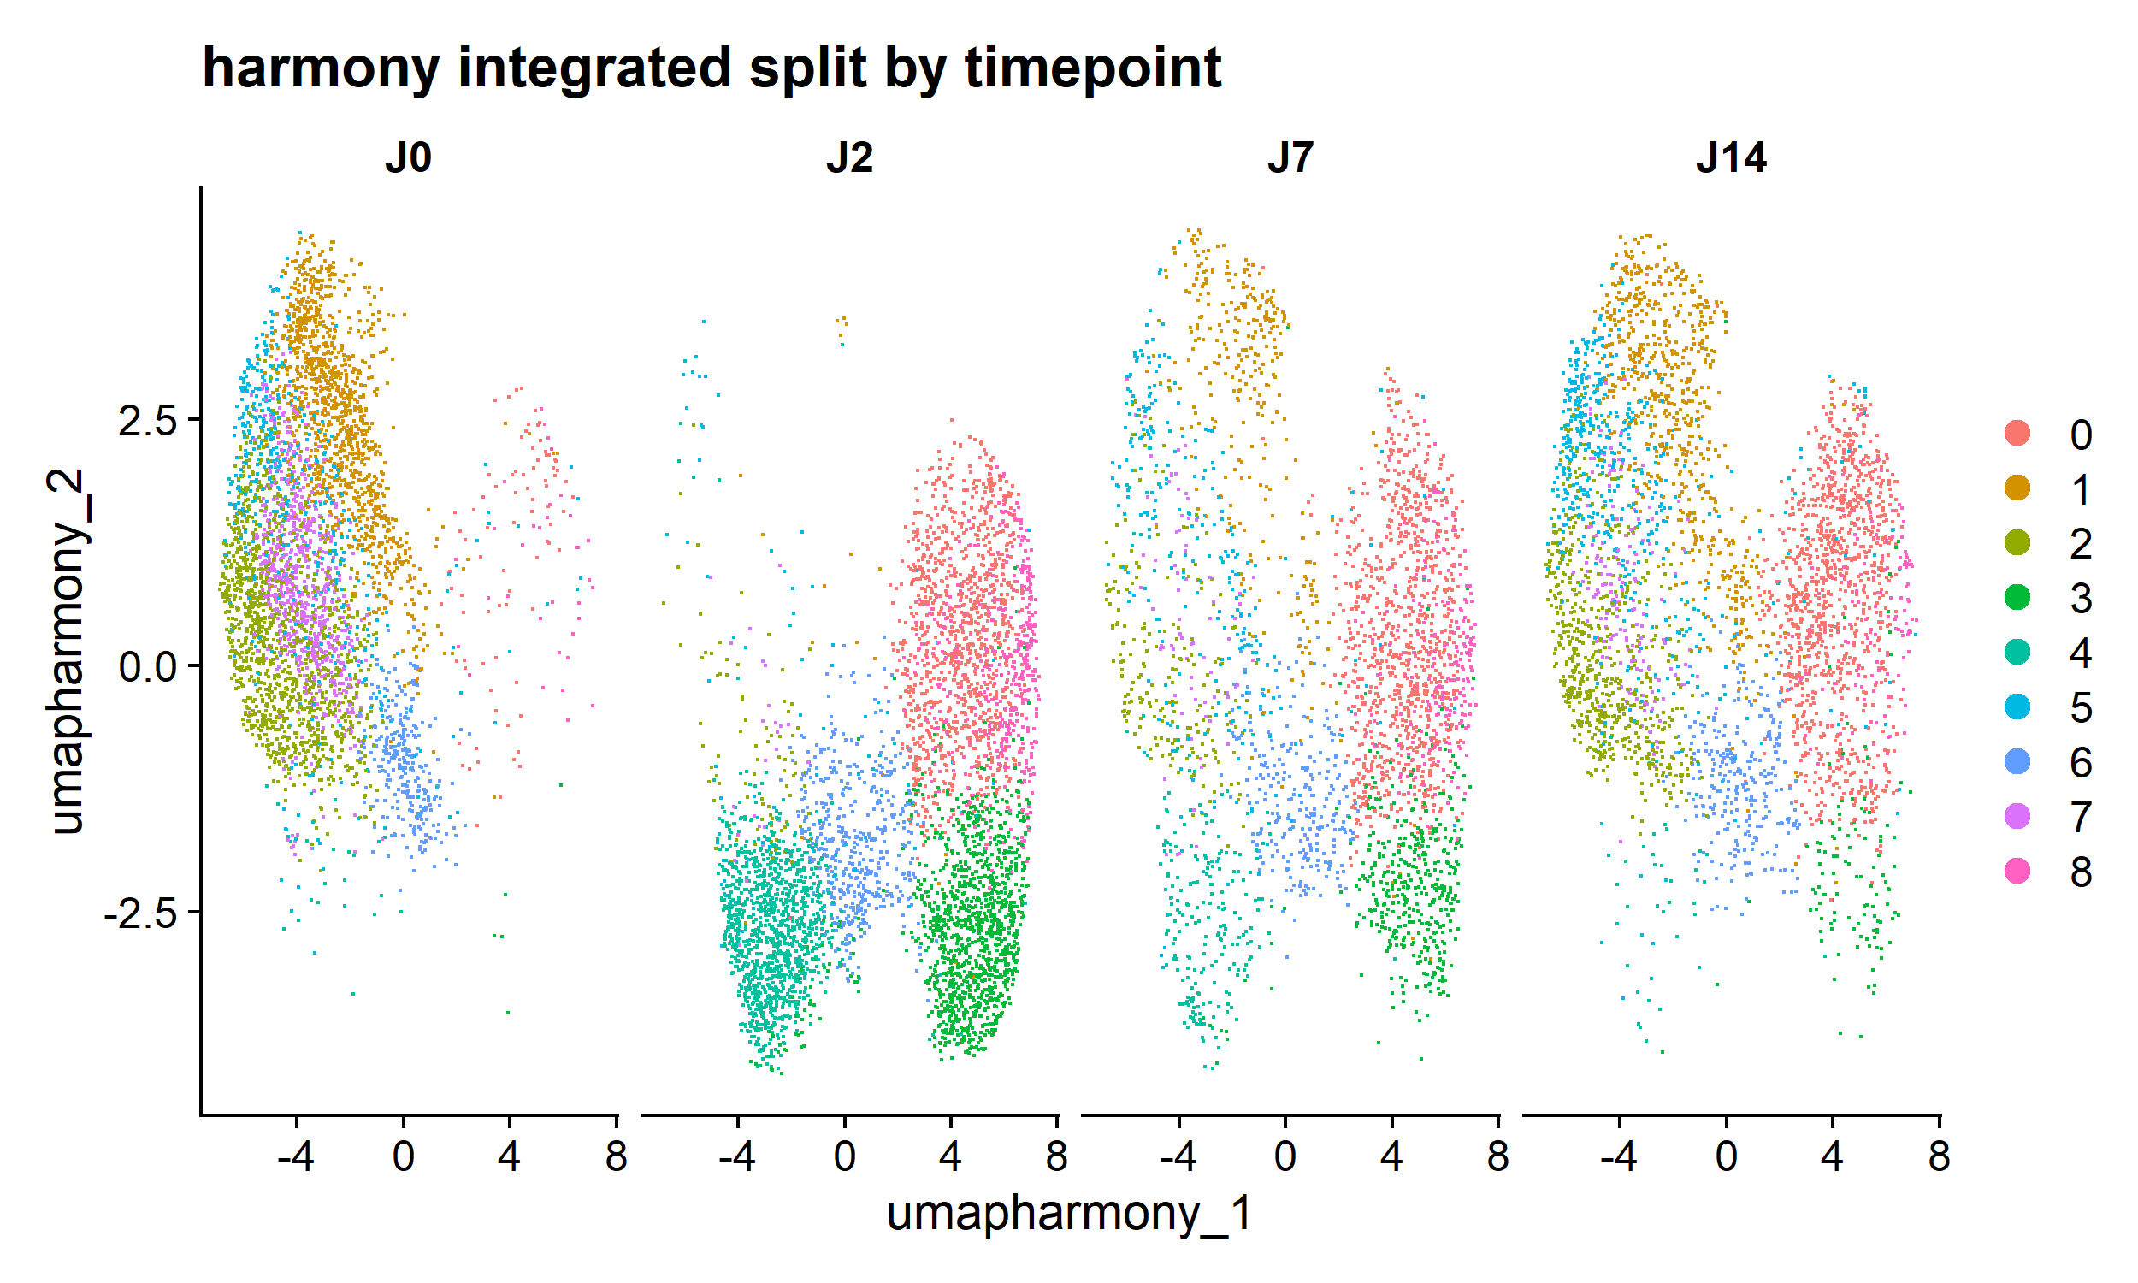
uoc.edu

Slide 26
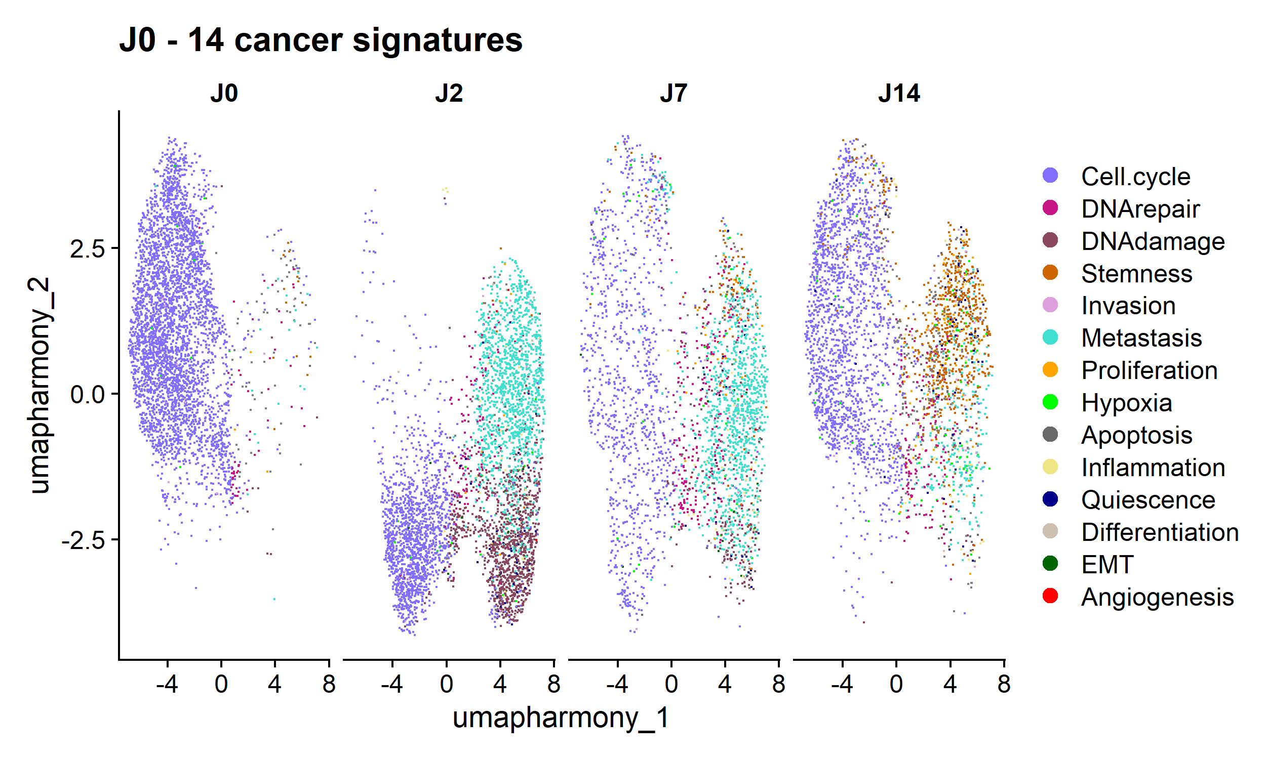
uoc.edu

Slide 27
uoc.edu

Slide 28
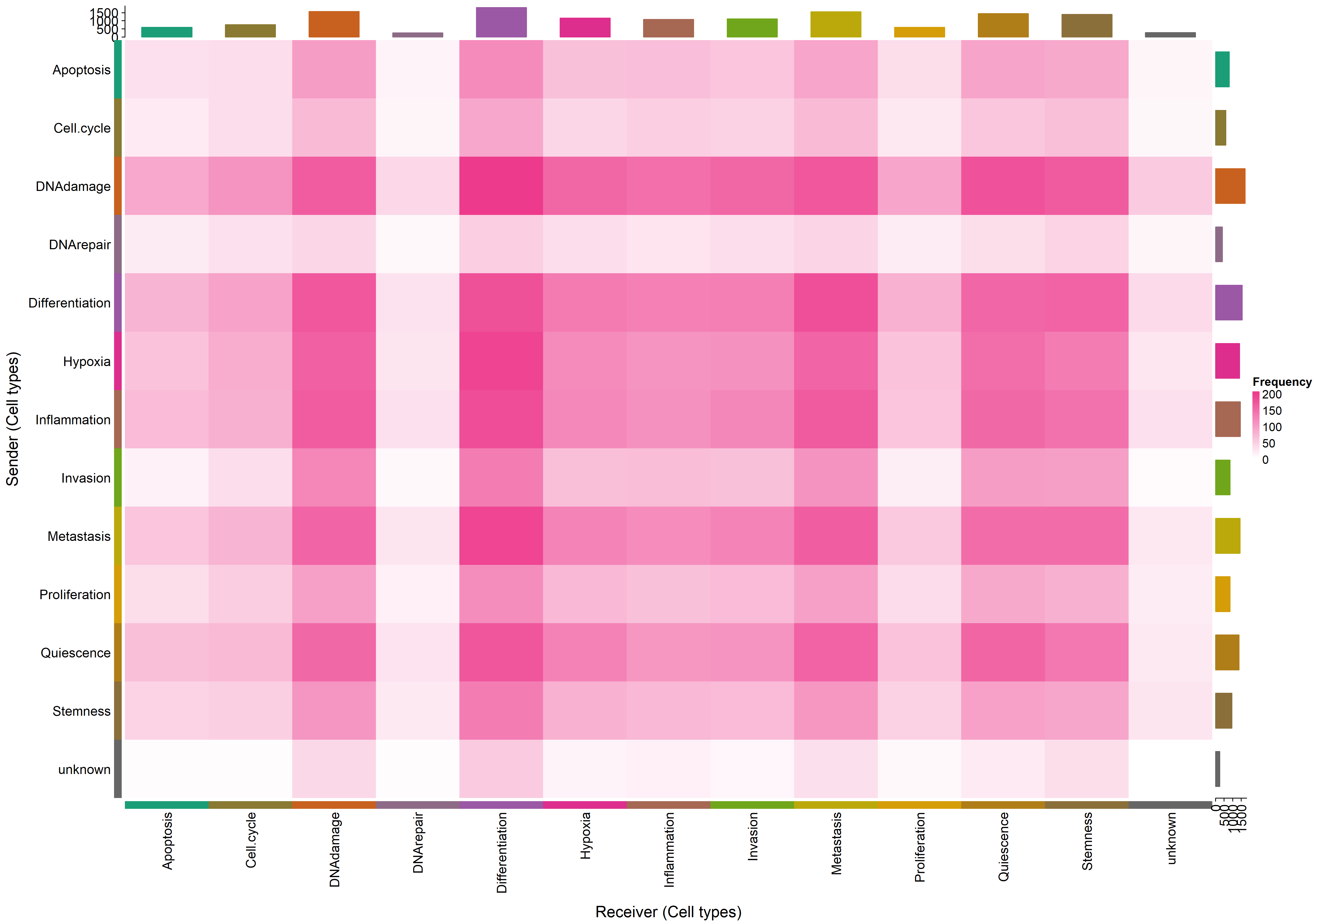
uoc.edu

Slide 29
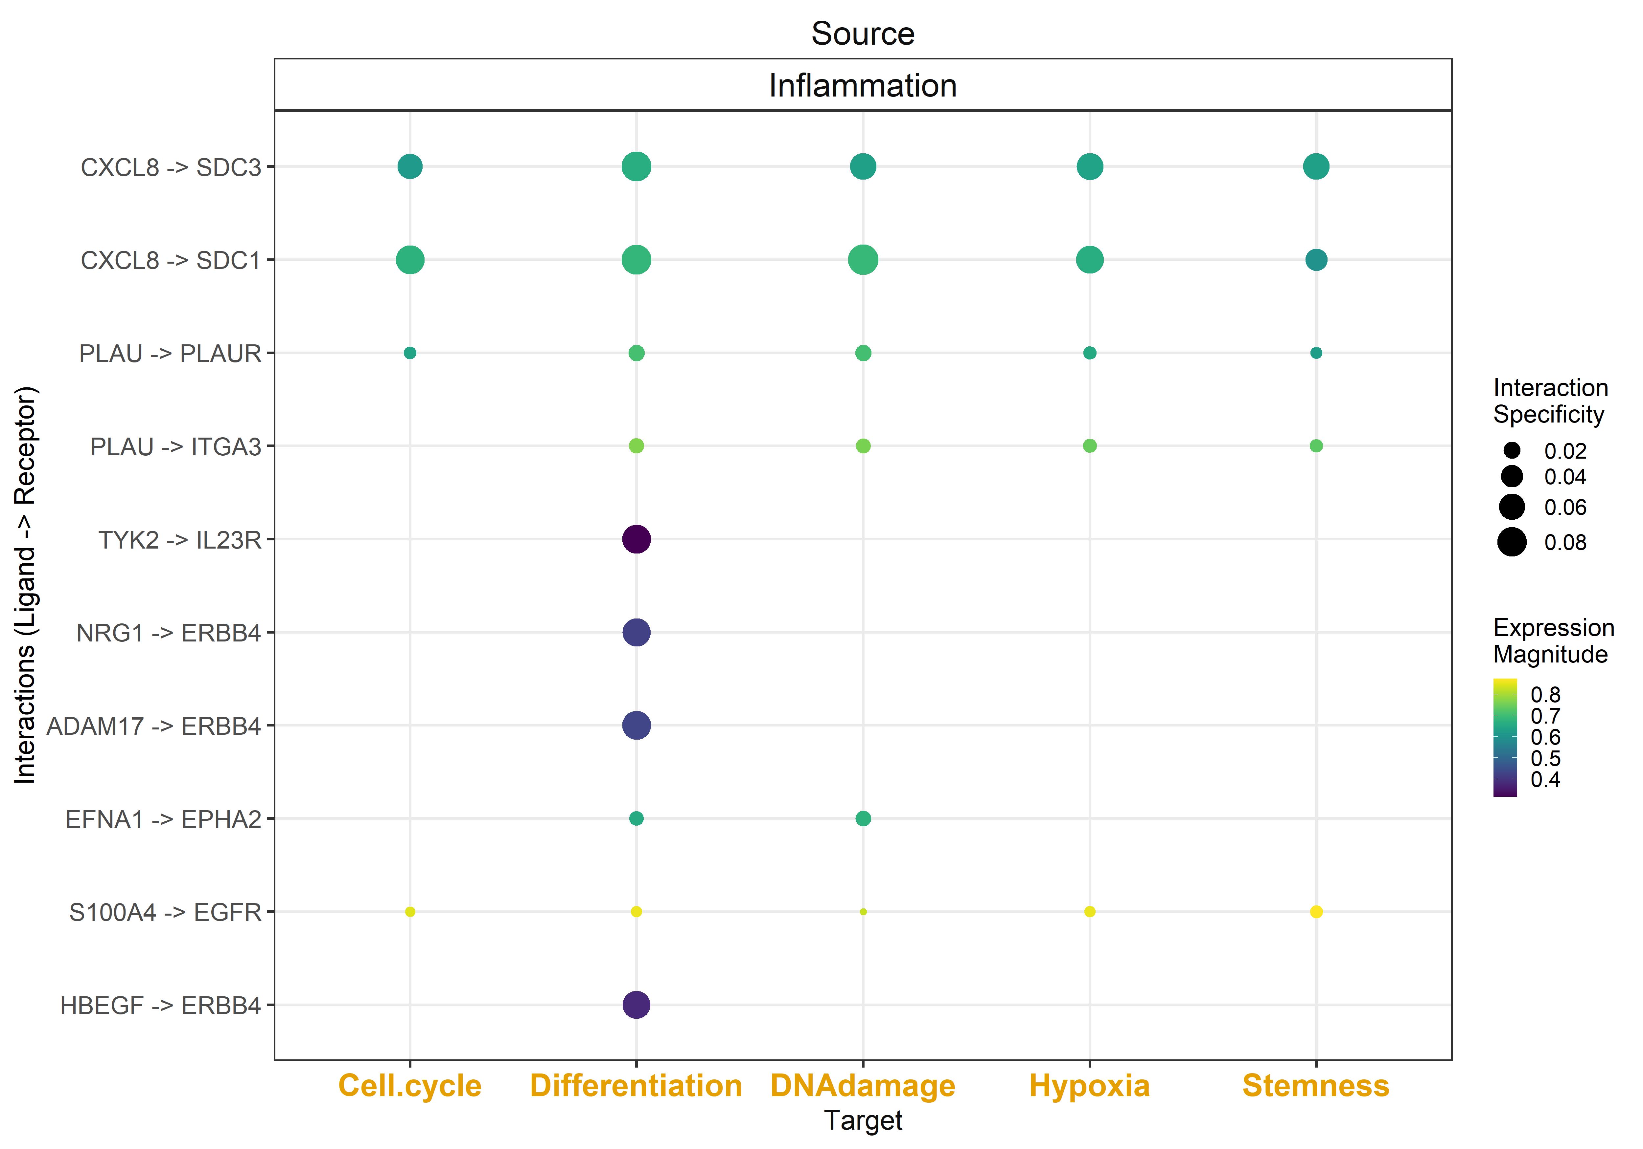
uoc.edu

Slide 30
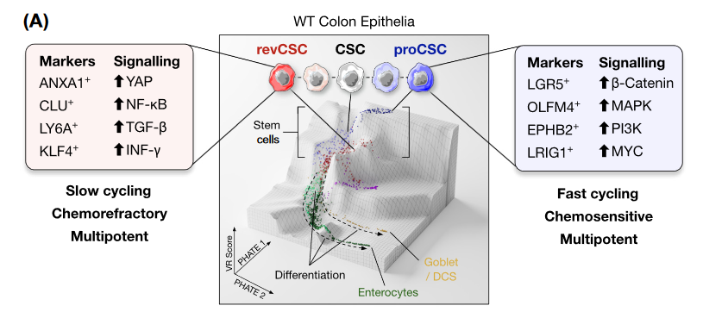
uoc.edu

Slide 31
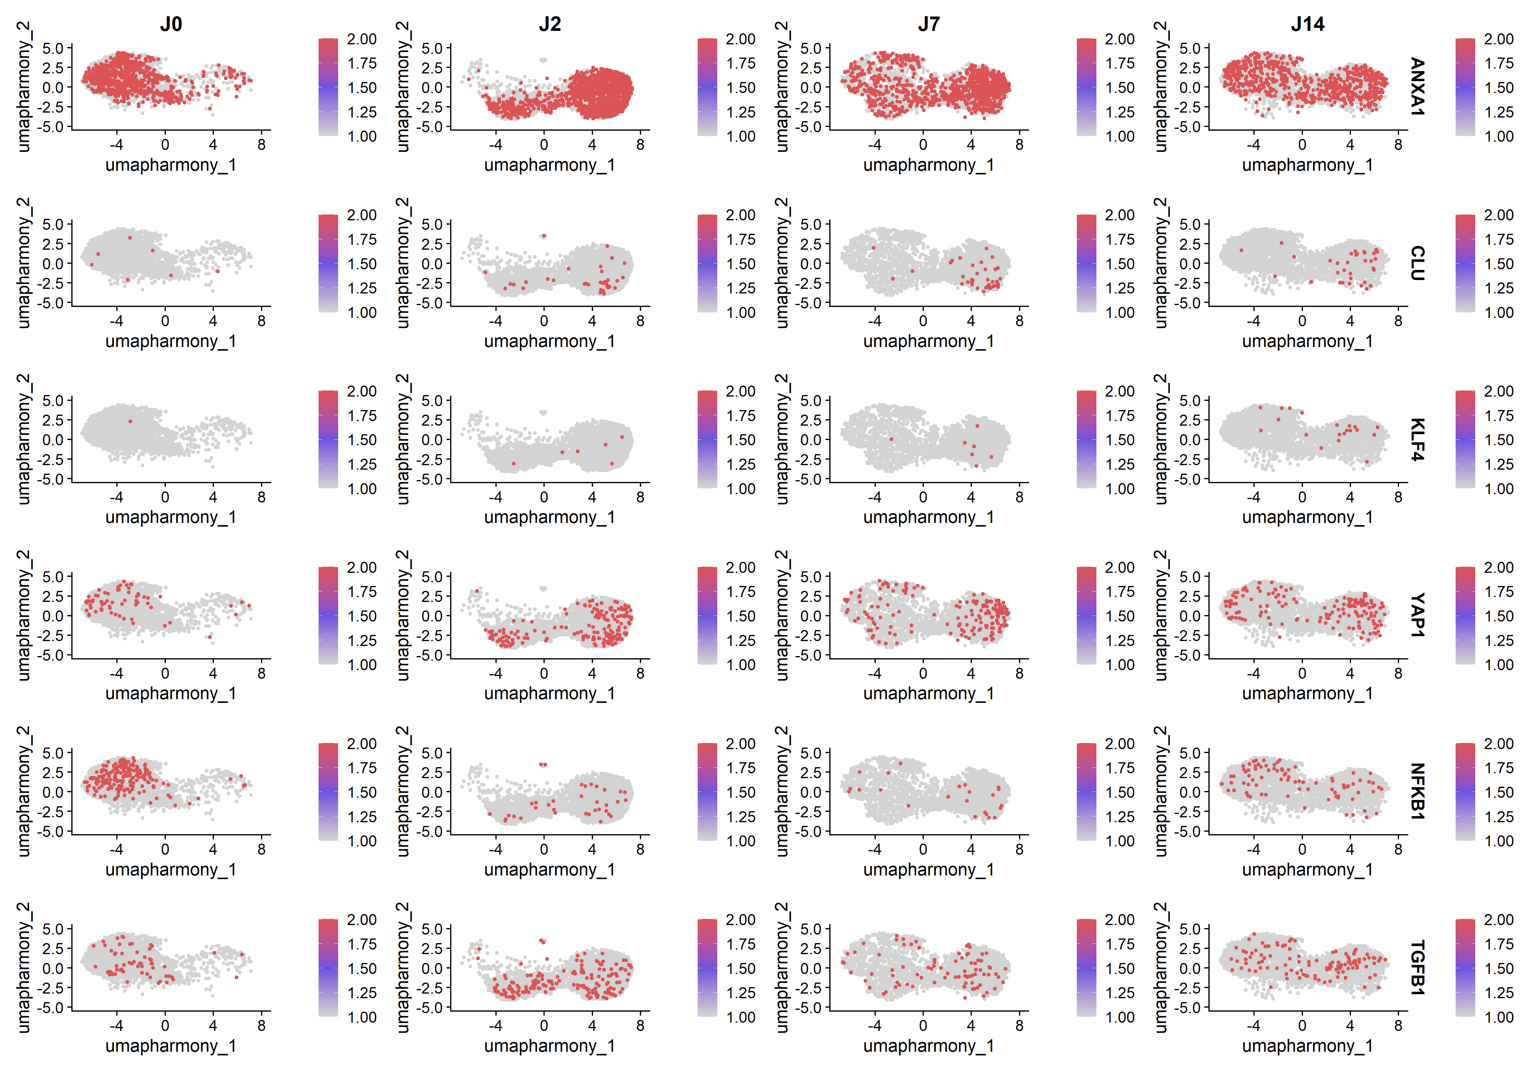
uoc.edu
Notes:
revCSC

Slide 32
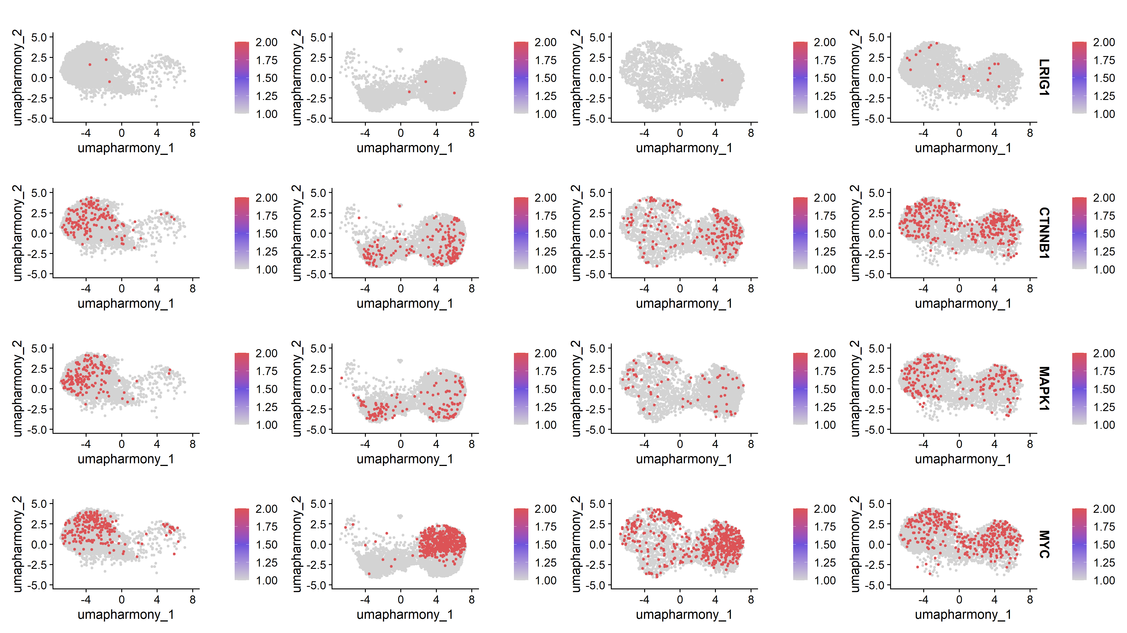
uoc.edu
Notes:
proCSC

